Slide 1
POSTER SHOW Group 3

Slide 2

Slide 1 of 160
Notes:
https://cs1033.gaul.csd.uwo.ca/~jkellar6/posterassign/jkellar6_poster.jpg

Slide 3

Slide 2 of 160
Notes:
https://cs1033.gaul.csd.uwo.ca/~jkim3226/posterassign/jkim3226_poster.jpg

Slide 4

Slide 3 of 160
Notes:
https://cs1033.gaul.csd.uwo.ca/~jkim3257/posterassign/jkim3257_poster.jpg

Slide 5
Slide 4 of 160
Notes:
https://cs1033.gaul.csd.uwo.ca/~jkravic/posterassign/jkravic_poster.jpg

Slide 6

Slide 5 of 160
Notes:
https://cs1033.gaul.csd.uwo.ca/~jkruger8/posterassign/jkruger8_poster.jpg

Slide 7
Slide 6 of 160
Notes:
https://cs1033.gaul.csd.uwo.ca/~jlepp5/posterassign/jlepp5_poster.jpg

Slide 8

Slide 7 of 160
Notes:
https://cs1033.gaul.csd.uwo.ca/~jli4963/posterassign/jli4963_poster.jpg

Slide 9

Slide 8 of 160
Notes:
https://cs1033.gaul.csd.uwo.ca/~jlian422/posterassign/jlian422_poster.jpg

Slide 10

Slide 9 of 160
Notes:
https://cs1033.gaul.csd.uwo.ca/~jlin846/posterassign/jlin846_poster.jpg

Slide 11

Slide 10 of 160
Notes:
https://cs1033.gaul.csd.uwo.ca/~jliu3254/posterassign/jliu3254_poster.jpg

Slide 12

Slide 11 of 160
Notes:
https://cs1033.gaul.csd.uwo.ca/~jliu3449/posterassign/jliu3449_poster.jpg

Slide 13

Slide 12 of 160
Notes:
https://cs1033.gaul.csd.uwo.ca/~jliu3535/posterassign/jliu3535_poster.jpg

Slide 14

Slide 13 of 160
Notes:
https://cs1033.gaul.csd.uwo.ca/~jluo389/posterassign/jluo389_poster.jpg

Slide 15

Slide 14 of 160
Notes:
https://cs1033.gaul.csd.uwo.ca/~jmehra2/posterassign/jmehra2_poster.jpg

Slide 16

Slide 15 of 160
Notes:
https://cs1033.gaul.csd.uwo.ca/~jmilberg/posterassign/jmilberg_poster.jpg

Slide 17

Slide 16 of 160
Notes:
https://cs1033.gaul.csd.uwo.ca/~jmill339/posterassign/jmill339_poster.jpg

Slide 18

Slide 17 of 160
Notes:
https://cs1033.gaul.csd.uwo.ca/~jng392/posterassign/jng392_poster.jpg

Slide 19

Slide 18 of 160
Notes:
https://cs1033.gaul.csd.uwo.ca/~jrainone/posterassign/jrainone_poster.jpg

Slide 20

Slide 19 of 160
Notes:
https://cs1033.gaul.csd.uwo.ca/~jrittenb/posterassign/jrittenb_poster.jpg

Slide 21

Slide 20 of 160
Notes:
https://cs1033.gaul.csd.uwo.ca/~jryu45/posterassign/jryu45_poster.jpg

Slide 22

Slide 21 of 160
Notes:
https://cs1033.gaul.csd.uwo.ca/~jsharefe/posterassign/jsharefe_poster.jpg

Slide 23

Slide 22 of 160
Notes:
https://cs1033.gaul.csd.uwo.ca/~jsmintic/posterassign/jsmintic_poster.jpg

Slide 24
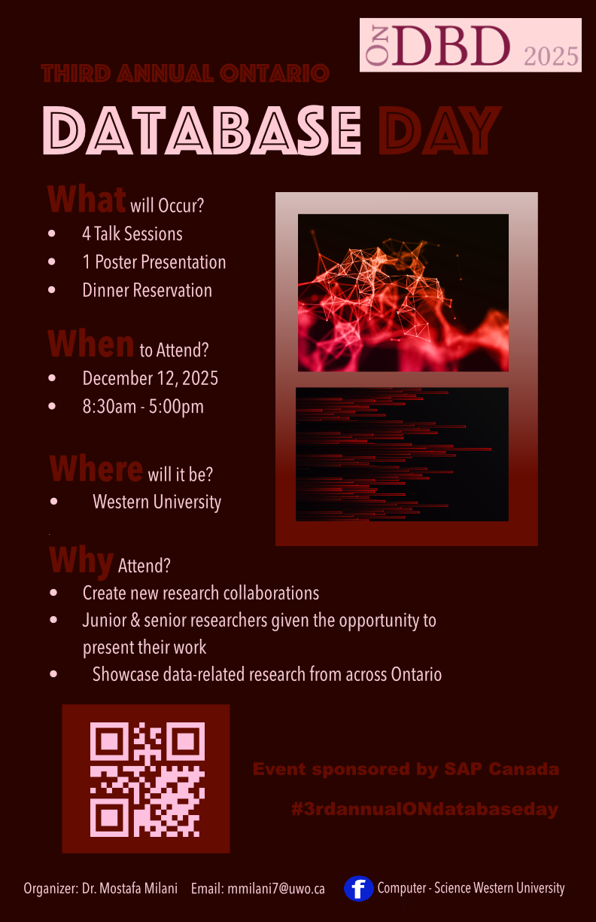
Slide 23 of 160
Notes:
https://cs1033.gaul.csd.uwo.ca/~jstefan6/posterassign/jstefan6_poster.jpg

Slide 25

Slide 24 of 160
Notes:
https://cs1033.gaul.csd.uwo.ca/~jstern33/posterassign/jstern33_poster.jpg

Slide 26

Slide 25 of 160
Notes:
https://cs1033.gaul.csd.uwo.ca/~jstev24/posterassign/jstev24_poster.jpg

Slide 27

Slide 26 of 160
Notes:
https://cs1033.gaul.csd.uwo.ca/~jstev26/posterassign/jstev26_poster.jpg

Slide 28

Slide 27 of 160
Notes:
https://cs1033.gaul.csd.uwo.ca/~jsun786/posterassign/jsun786_poster.jpg

Slide 29

Slide 28 of 160
Notes:
https://cs1033.gaul.csd.uwo.ca/~jtattum/posterassign/jtattum_poster.jpg

Slide 30

Slide 29 of 160
Notes:
https://cs1033.gaul.csd.uwo.ca/~jthom483/posterassign/jthom483_poster.jpg

Slide 31

Slide 30 of 160
Notes:
https://cs1033.gaul.csd.uwo.ca/~jwan3624/posterassign/jwan3624_poster.jpg

Slide 32

Slide 31 of 160
Notes:
https://cs1033.gaul.csd.uwo.ca/~jwierda/posterassign/jwierda_poster.jpg

Slide 33

Slide 32 of 160
Notes:
https://cs1033.gaul.csd.uwo.ca/~jxu2272/posterassign/jxu2272_poster.jpg

Slide 34

Slide 33 of 160
Notes:
https://cs1033.gaul.csd.uwo.ca/~jxu965/posterassign/jxu965_poster.jpg

Slide 35

Slide 34 of 160
Notes:
https://cs1033.gaul.csd.uwo.ca/~jyan583/posterassign/jyan583_poster.jpg

Slide 36

Slide 35 of 160
Notes:
https://cs1033.gaul.csd.uwo.ca/~jyan778/posterassign/jyan778_poster.jpg

Slide 37

Slide 36 of 160
Notes:
https://cs1033.gaul.csd.uwo.ca/~jzha2432/posterassign/jzha2432_poster.jpg

Slide 38

Slide 37 of 160
Notes:
https://cs1033.gaul.csd.uwo.ca/~jzha2624/posterassign/jzha2624_poster.jpg

Slide 39
Slide 38 of 160
Notes:
https://cs1033.gaul.csd.uwo.ca/~jzha2872/posterassign/jzha2872_poster.jpg

Slide 40

Slide 39 of 160
Notes:
https://cs1033.gaul.csd.uwo.ca/~jzhou777/posterassign/jzhou777_poster.jpg

Slide 41

Slide 40 of 160
Notes:
https://cs1033.gaul.csd.uwo.ca/~jzhou824/posterassign/jzhou824_poster.jpg

Slide 42

Slide 41 of 160
Notes:
https://cs1033.gaul.csd.uwo.ca/~kballer/posterassign/kballer_poster.jpg

Slide 43
Slide 42 of 160
Notes:
https://cs1033.gaul.csd.uwo.ca/~kbaring/posterassign/kbaring_poster.jpg

Slide 44

Slide 43 of 160
Notes:
https://cs1033.gaul.csd.uwo.ca/~kbhanda6/posterassign/kbhanda6_poster.jpg

Slide 45

Slide 44 of 160
Notes:
https://cs1033.gaul.csd.uwo.ca/~kchan766/posterassign/kchan766_poster.jpg

Slide 46

Slide 45 of 160
Notes:
https://cs1033.gaul.csd.uwo.ca/~kchang82/posterassign/kchang82_poster.jpg

Slide 47
Slide 46 of 160
Notes:
https://cs1033.gaul.csd.uwo.ca/~kchurc4/posterassign/kchurc4_poster.jpg

Slide 48

Slide 47 of 160
Notes:
https://cs1033.gaul.csd.uwo.ca/~kdean29/posterassign/kdean29_poster.jpg

Slide 49

Slide 48 of 160
Notes:
https://cs1033.gaul.csd.uwo.ca/~kdeol9/posterassign/kdeol9_poster.jpg

Slide 50

Slide 49 of 160
Notes:
https://cs1033.gaul.csd.uwo.ca/~kdryboro/posterassign/kdryboro_poster.jpg

Slide 51

Slide 50 of 160
Notes:
https://cs1033.gaul.csd.uwo.ca/~kfan59/posterassign/kfan59_poster.jpg

Slide 52

Slide 51 of 160
Notes:
https://cs1033.gaul.csd.uwo.ca/~kfeng66/posterassign/kfeng66_poster.jpg

Slide 53

Slide 52 of 160
Notes:
https://cs1033.gaul.csd.uwo.ca/~kkim548/posterassign/kkim548_poster.jpg

Slide 54

Slide 53 of 160
Notes:
https://cs1033.gaul.csd.uwo.ca/~klai252/posterassign/klai252_poster.jpg

Slide 55

Slide 54 of 160
Notes:
https://cs1033.gaul.csd.uwo.ca/~klancas4/posterassign/klancas4_poster.jpg

Slide 56

Slide 55 of 160
Notes:
https://cs1033.gaul.csd.uwo.ca/~klangst2/posterassign/klangst2_poster.jpg

Slide 57

Slide 56 of 160
Notes:
https://cs1033.gaul.csd.uwo.ca/~klee963/posterassign/klee963_poster.jpg

Slide 58

Slide 57 of 160
Notes:
https://cs1033.gaul.csd.uwo.ca/~kliang69/posterassign/kliang69_poster.jpg

Slide 59

Slide 58 of 160
Notes:
https://cs1033.gaul.csd.uwo.ca/~kma294/posterassign/kma294_poster.jpg

Slide 60

Slide 59 of 160
Notes:
https://cs1033.gaul.csd.uwo.ca/~kmachad/posterassign/kmachad_poster.jpg

Slide 61
Slide 60 of 160
Notes:
https://cs1033.gaul.csd.uwo.ca/~kmak62/posterassign/kmak62_poster.jpg

Slide 62
Slide 61 of 160
Notes:
https://cs1033.gaul.csd.uwo.ca/~kmakalon/posterassign/kmakalon_poster.jpg

Slide 63

Slide 62 of 160
Notes:
https://cs1033.gaul.csd.uwo.ca/~kmatheng/posterassign/kmatheng_poster.jpg

Slide 64

Slide 63 of 160
Notes:
https://cs1033.gaul.csd.uwo.ca/~kng386/posterassign/kng386_poster.jpg

Slide 65

Slide 64 of 160
Notes:
https://cs1033.gaul.csd.uwo.ca/~kng393/posterassign/kng393_poster.jpg

Slide 66

Slide 65 of 160
Notes:
https://cs1033.gaul.csd.uwo.ca/~knhan5/posterassign/knhan5_poster.jpg

Slide 67

Slide 66 of 160
Notes:
https://cs1033.gaul.csd.uwo.ca/~kou9/posterassign/kou9_poster.jpg

Slide 68

Slide 67 of 160
Notes:
https://cs1033.gaul.csd.uwo.ca/~kpate847/posterassign/kpate847_poster.jpg

Slide 69

Slide 68 of 160
Notes:
https://cs1033.gaul.csd.uwo.ca/~krow2/posterassign/krow2_poster.jpg

Slide 70

Slide 69 of 160
Notes:
https://cs1033.gaul.csd.uwo.ca/~kryu7/posterassign/kryu7_poster.jpg

Slide 71

Slide 70 of 160
Notes:
https://cs1033.gaul.csd.uwo.ca/~ksaadat2/posterassign/ksaadat2_poster.jpg

Slide 72

Slide 71 of 160
Notes:
https://cs1033.gaul.csd.uwo.ca/~kthiyag7/posterassign/kthiyag7_poster.jpg

Slide 73

Slide 72 of 160
Notes:
https://cs1033.gaul.csd.uwo.ca/~ktrinh5/posterassign/ktrinh5_poster.jpg

Slide 74

Slide 73 of 160
Notes:
https://cs1033.gaul.csd.uwo.ca/~kvigilan/posterassign/kvigilan_poster.jpg

Slide 75

Slide 74 of 160
Notes:
https://cs1033.gaul.csd.uwo.ca/~kwang847/posterassign/kwang847_poster.jpg

Slide 76
Slide 75 of 160
Notes:
https://cs1033.gaul.csd.uwo.ca/~kxu339/posterassign/kxu339_poster.jpg

Slide 77

Slide 76 of 160
Notes:
https://cs1033.gaul.csd.uwo.ca/~kzhan542/posterassign/kzhan542_poster.jpg

Slide 78

Slide 77 of 160
Notes:
https://cs1033.gaul.csd.uwo.ca/~lchen974/posterassign/lchen974_poster.jpg

Slide 79

Slide 78 of 160
Notes:
https://cs1033.gaul.csd.uwo.ca/~lcook64/posterassign/lcook64_poster.jpg

Slide 80

Slide 79 of 160
Notes:
https://cs1033.gaul.csd.uwo.ca/~ldolbel/posterassign/ldolbel_poster.jpg

Slide 81
Slide 80 of 160
Notes:
https://cs1033.gaul.csd.uwo.ca/~lgojkovi/posterassign/lgojkovi_poster.jpg

Slide 82

Slide 81 of 160
Notes:
https://cs1033.gaul.csd.uwo.ca/~lkay26/posterassign/lkay26_poster.jpg

Slide 83

Slide 82 of 160
Notes:
https://cs1033.gaul.csd.uwo.ca/~llancas/posterassign/llancas_poster.jpg

Slide 84

Slide 83 of 160
Notes:
https://cs1033.gaul.csd.uwo.ca/~lli2242/posterassign/lli2242_poster.jpg

Slide 85

Slide 84 of 160
Notes:
https://cs1033.gaul.csd.uwo.ca/~lli822/posterassign/lli822_poster.jpg

Slide 86

Slide 85 of 160
Notes:
https://cs1033.gaul.csd.uwo.ca/~lli969/posterassign/lli969_poster.jpg

Slide 87
Slide 86 of 160
Notes:
https://cs1033.gaul.csd.uwo.ca/~llitvack/posterassign/llitvack_poster.jpg

Slide 88
Slide 87 of 160
Notes:
https://cs1033.gaul.csd.uwo.ca/~lliu767/posterassign/lliu767_poster.jpg

Slide 89

Slide 88 of 160
Notes:
https://cs1033.gaul.csd.uwo.ca/~lmacbrid/posterassign/lmacbrid_poster.jpg

Slide 90
Slide 89 of 160
Notes:
https://cs1033.gaul.csd.uwo.ca/~lmancus2/posterassign/lmancus2_poster.jpg

Slide 91

Slide 90 of 160
Notes:
https://cs1033.gaul.csd.uwo.ca/~lmcmil6/posterassign/lmcmil6_poster.jpg

Slide 92

Slide 91 of 160
Notes:
https://cs1033.gaul.csd.uwo.ca/~lnicolin/posterassign/lnicolin_poster.jpg

Slide 93

Slide 92 of 160
Notes:
https://cs1033.gaul.csd.uwo.ca/~lpergola/posterassign/lpergola_poster.jpg

Slide 94
Slide 93 of 160
Notes:
https://cs1033.gaul.csd.uwo.ca/~lpustil/posterassign/lpustil_poster.jpg

Slide 95

Slide 94 of 160
Notes:
https://cs1033.gaul.csd.uwo.ca/~lraj3/posterassign/lraj3_poster.jpg

Slide 96

Slide 95 of 160
Notes:
https://cs1033.gaul.csd.uwo.ca/~lrake/posterassign/lrake_poster.jpg

Slide 97

Slide 96 of 160
Notes:
https://cs1033.gaul.csd.uwo.ca/~lsun343/posterassign/lsun343_poster.jpg

Slide 98

Slide 97 of 160
Notes:
https://cs1033.gaul.csd.uwo.ca/~lvelacka/posterassign/lvelacka_poster.jpg

Slide 99

Slide 98 of 160
Notes:
https://cs1033.gaul.csd.uwo.ca/~lwarre/posterassign/lwarre_poster.jpg

Slide 100

Slide 99 of 160
Notes:
https://cs1033.gaul.csd.uwo.ca/~lwojcik2/posterassign/lwojcik2_poster.jpg

Slide 101

Slide 100 of 160
Notes:
https://cs1033.gaul.csd.uwo.ca/~lyoveti/posterassign/lyoveti_poster.jpg

Slide 102

Slide 101 of 160
Notes:
https://cs1033.gaul.csd.uwo.ca/~mallis4/posterassign/mallis4_poster.jpg

Slide 103

Slide 102 of 160
Notes:
https://cs1033.gaul.csd.uwo.ca/~mbabuthu/posterassign/mbabuthu_poster.jpg

Slide 104

Slide 103 of 160
Notes:
https://cs1033.gaul.csd.uwo.ca/~mbake33/posterassign/mbake33_poster.jpg

Slide 105

Slide 104 of 160
Notes:
https://cs1033.gaul.csd.uwo.ca/~mbarkov/posterassign/mbarkov_poster.jpg

Slide 106

Slide 105 of 160
Notes:
https://cs1033.gaul.csd.uwo.ca/~mbratchd/posterassign/mbratchd_poster.jpg

Slide 107

Slide 106 of 160
Notes:
https://cs1033.gaul.csd.uwo.ca/~mbuckla4/posterassign/mbuckla4_poster.jpg

Slide 108

Slide 107 of 160
Notes:
https://cs1033.gaul.csd.uwo.ca/~mcamer83/posterassign/mcamer83_poster.jpg

Slide 109

Slide 108 of 160
Notes:
https://cs1033.gaul.csd.uwo.ca/~mcardoz2/posterassign/mcardoz2_poster.jpg

Slide 110

Slide 109 of 160
Notes:
https://cs1033.gaul.csd.uwo.ca/~mchand43/posterassign/mchand43_poster.jpg

Slide 111

Slide 110 of 160
Notes:
https://cs1033.gaul.csd.uwo.ca/~mchen886/posterassign/mchen886_poster.jpg

Slide 112

Slide 111 of 160
Notes:
https://cs1033.gaul.csd.uwo.ca/~mchen897/posterassign/mchen897_poster.jpg

Slide 113

Slide 112 of 160
Notes:
https://cs1033.gaul.csd.uwo.ca/~mcontway/posterassign/mcontway_poster.jpg

Slide 114

Slide 113 of 160
Notes:
https://cs1033.gaul.csd.uwo.ca/~mderatn/posterassign/mderatn_poster.jpg

Slide 115
Slide 114 of 160
Notes:
https://cs1033.gaul.csd.uwo.ca/~mdicks5/posterassign/mdicks5_poster.jpg

Slide 116

Slide 115 of 160
Notes:
https://cs1033.gaul.csd.uwo.ca/~melshik/posterassign/melshik_poster.jpg

Slide 117

Slide 116 of 160
Notes:
https://cs1033.gaul.csd.uwo.ca/~meltawdy/posterassign/meltawdy_poster.jpg

Slide 118

Slide 117 of 160
Notes:
https://cs1033.gaul.csd.uwo.ca/~mfinnega/posterassign/mfinnega_poster.jpg

Slide 119

Slide 118 of 160
Notes:
https://cs1033.gaul.csd.uwo.ca/~mgill286/posterassign/mgill286_poster.jpg

Slide 120

Slide 119 of 160
Notes:
https://cs1033.gaul.csd.uwo.ca/~mgilson2/posterassign/mgilson2_poster.jpg

Slide 121
Slide 120 of 160
Notes:
https://cs1033.gaul.csd.uwo.ca/~mgitlin/posterassign/mgitlin_poster.jpg

Slide 122
Slide 121 of 160
Notes:
https://cs1033.gaul.csd.uwo.ca/~mgray233/posterassign/mgray233_poster.jpg

Slide 123

Slide 122 of 160
Notes:
https://cs1033.gaul.csd.uwo.ca/~mho332/posterassign/mho332_poster.jpg

Slide 124

Slide 123 of 160
Notes:
https://cs1033.gaul.csd.uwo.ca/~mhubache/posterassign/mhubache_poster.jpg

Slide 125

Slide 124 of 160
Notes:
https://cs1033.gaul.csd.uwo.ca/~mip8/posterassign/mip8_poster.jpg

Slide 126

Slide 125 of 160
Notes:
https://cs1033.gaul.csd.uwo.ca/~mjangin/posterassign/mjangin_poster.jpg

Slide 127

Slide 126 of 160
Notes:
https://cs1033.gaul.csd.uwo.ca/~mkalogri/posterassign/mkalogri_poster.jpg

Slide 128

Slide 127 of 160
Notes:
https://cs1033.gaul.csd.uwo.ca/~mkaye6/posterassign/mkaye6_poster.jpg

Slide 129

Slide 128 of 160
Notes:
https://cs1033.gaul.csd.uwo.ca/~mkhawa5/posterassign/mkhawa5_poster.jpg

Slide 130

Slide 129 of 160
Notes:
https://cs1033.gaul.csd.uwo.ca/~mlebla68/posterassign/mlebla68_poster.jpg

Slide 131

Slide 130 of 160
Notes:
https://cs1033.gaul.csd.uwo.ca/~mlee2249/posterassign/mlee2249_poster.jpg

Slide 132

Slide 131 of 160
Notes:
https://cs1033.gaul.csd.uwo.ca/~mlewis89/posterassign/mlewis89_poster.jpg

Slide 133

Slide 132 of 160
Notes:
https://cs1033.gaul.csd.uwo.ca/~mmachan5/posterassign/mmachan5_poster.jpg

Slide 134

Slide 133 of 160
Notes:
https://cs1033.gaul.csd.uwo.ca/~mmartnez/posterassign/mmartnez_poster.jpg

Slide 135
Slide 134 of 160
Notes:
https://cs1033.gaul.csd.uwo.ca/~mmenikga/posterassign/mmenikga_poster.jpg

Slide 136

Slide 135 of 160
Notes:
https://cs1033.gaul.csd.uwo.ca/~mmonson3/posterassign/mmonson3_poster.jpg

Slide 137
Slide 136 of 160
Notes:
https://cs1033.gaul.csd.uwo.ca/~mmurp63/posterassign/mmurp63_poster.jpg

Slide 138
Slide 137 of 160
Notes:
https://cs1033.gaul.csd.uwo.ca/~mnicoli2/posterassign/mnicoli2_poster.jpg

Slide 139
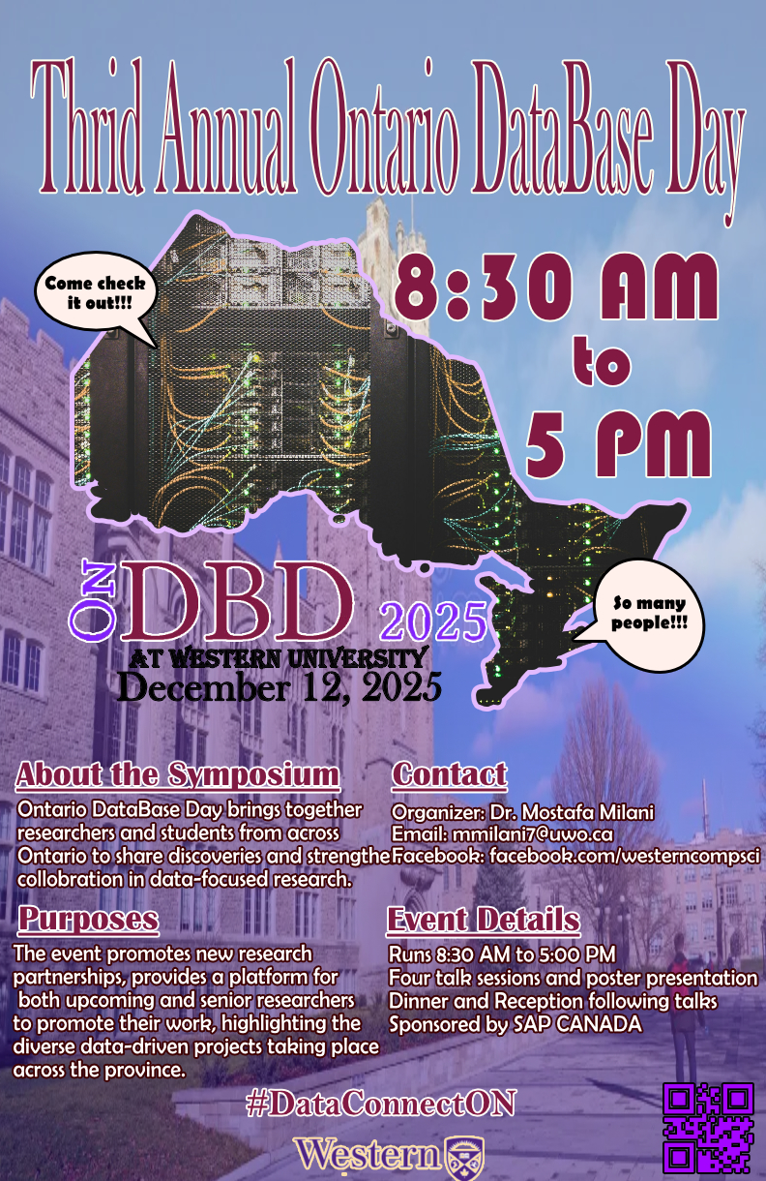
Slide 138 of 160
Notes:
https://cs1033.gaul.csd.uwo.ca/~mponwar2/posterassign/mponwar2_poster.jpg

Slide 140
Slide 139 of 160
Notes:
https://cs1033.gaul.csd.uwo.ca/~mprinc3/posterassign/mprinc3_poster.jpg

Slide 141

Slide 140 of 160
Notes:
https://cs1033.gaul.csd.uwo.ca/~mrobe243/posterassign/mrobe243_poster.jpg

Slide 142

Slide 141 of 160
Notes:
https://cs1033.gaul.csd.uwo.ca/~msabeti3/posterassign/msabeti3_poster.jpg

Slide 143

Slide 142 of 160
Notes:
https://cs1033.gaul.csd.uwo.ca/~msayyid/posterassign/msayyid_poster.jpg

Slide 144

Slide 143 of 160
Notes:
https://cs1033.gaul.csd.uwo.ca/~mscorna/posterassign/mscorna_poster.jpg

Slide 145

Slide 144 of 160
Notes:
https://cs1033.gaul.csd.uwo.ca/~mshimabu/posterassign/mshimabu_poster.jpg

Slide 146

Slide 145 of 160
Notes:
https://cs1033.gaul.csd.uwo.ca/~msidd88/posterassign/msidd88_poster.jpg

Slide 147

Slide 146 of 160
Notes:
https://cs1033.gaul.csd.uwo.ca/~msparks6/posterassign/msparks6_poster.jpg

Slide 148

Slide 147 of 160
Notes:
https://cs1033.gaul.csd.uwo.ca/~msuprun/posterassign/msuprun_poster.jpg

Slide 149
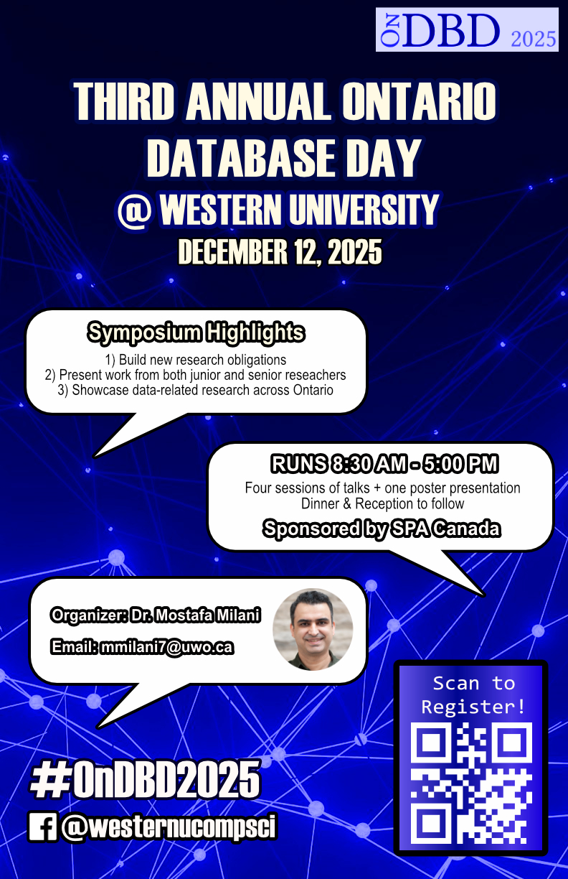
Slide 148 of 160
Notes:
https://cs1033.gaul.csd.uwo.ca/~mtan96/posterassign/mtan96_poster.jpg

Slide 150

Slide 149 of 160
Notes:
https://cs1033.gaul.csd.uwo.ca/~mtariq67/posterassign/mtariq67_poster.jpg

Slide 151

Slide 150 of 160
Notes:
https://cs1033.gaul.csd.uwo.ca/~mtian58/posterassign/mtian58_poster.jpg

Slide 152

Slide 151 of 160
Notes:
https://cs1033.gaul.csd.uwo.ca/~mtran322/posterassign/mtran322_poster.jpg

Slide 153
Slide 152 of 160
Notes:
https://cs1033.gaul.csd.uwo.ca/~mvaler/posterassign/mvaler_poster.jpg

Slide 154

Slide 153 of 160
Notes:
https://cs1033.gaul.csd.uwo.ca/~mweston8/posterassign/mweston8_poster.jpg

Slide 155

Slide 154 of 160
Notes:
https://cs1033.gaul.csd.uwo.ca/~myang454/posterassign/myang454_poster.jpg

Slide 156
Slide 155 of 160
Notes:
https://cs1033.gaul.csd.uwo.ca/~myang565/posterassign/myang565_poster.jpg

Slide 157

Slide 156 of 160
Notes:
https://cs1033.gaul.csd.uwo.ca/~myin62/posterassign/myin62_poster.jpg

Slide 158

Slide 157 of 160
Notes:
https://cs1033.gaul.csd.uwo.ca/~myuan97/posterassign/myuan97_poster.jpg

Slide 159
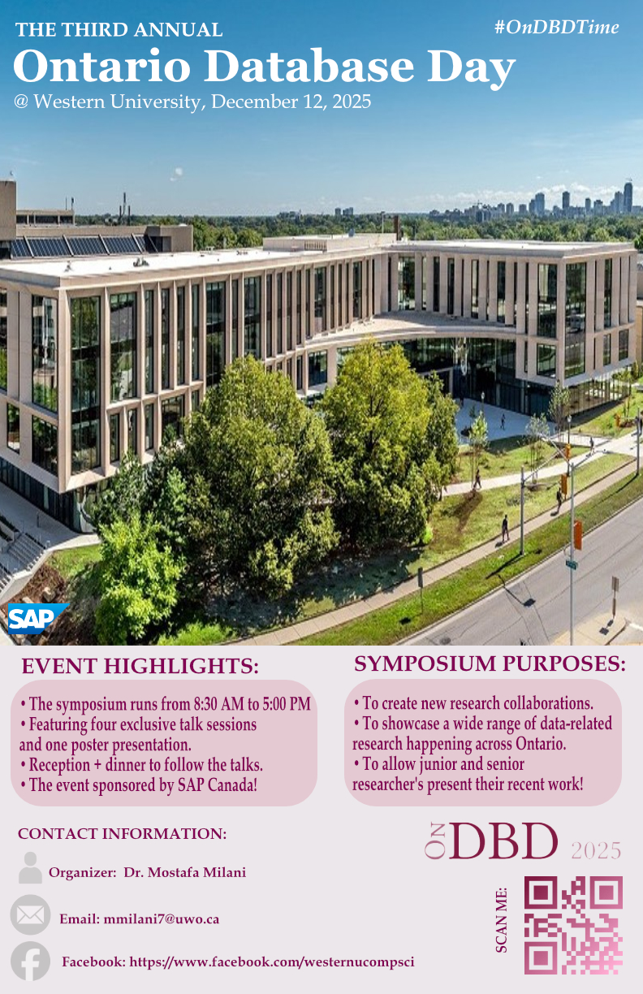
Slide 158 of 160
Notes:
https://cs1033.gaul.csd.uwo.ca/~nblair5/posterassign/nblair5_poster.jpg

Slide 160
Slide 159 of 160
Notes:
https://cs1033.gaul.csd.uwo.ca/~nblitste/posterassign/nblitste_poster.jpg

Slide 161
Slide 160 of 160
Notes:
https://cs1033.gaul.csd.uwo.ca/~nblum2/posterassign/nblum2_poster.jpg

