Slide 1
POSTER SHOW Group 4

Slide 2

Slide 1 of 160
Notes:
https://cs1033.gaul.csd.uwo.ca/~nfeldma9/posterassign/nfeldma9_poster.jpg

Slide 3

Slide 2 of 160
Notes:
https://cs1033.gaul.csd.uwo.ca/~nfong9/posterassign/nfong9_poster.jpg

Slide 4

Slide 3 of 160
Notes:
https://cs1033.gaul.csd.uwo.ca/~ngleeck/posterassign/ngleeck_poster.jpg

Slide 5

Slide 4 of 160
Notes:
https://cs1033.gaul.csd.uwo.ca/~ngoddar4/posterassign/ngoddar4_poster.jpg

Slide 6
Slide 5 of 160
Notes:
https://cs1033.gaul.csd.uwo.ca/~njalili4/posterassign/njalili4_poster.jpg

Slide 7

Slide 6 of 160
Notes:
https://cs1033.gaul.csd.uwo.ca/~nkhan344/posterassign/nkhan344_poster.jpg

Slide 8

Slide 7 of 160
Notes:
https://cs1033.gaul.csd.uwo.ca/~nle73/posterassign/nle73_poster.jpg

Slide 9
Slide 8 of 160
Notes:
https://cs1033.gaul.csd.uwo.ca/~nlevin8/posterassign/nlevin8_poster.jpg

Slide 10

Slide 9 of 160
Notes:
https://cs1033.gaul.csd.uwo.ca/~nmay24/posterassign/nmay24_poster.jpg

Slide 11
Slide 10 of 160
Notes:
https://cs1033.gaul.csd.uwo.ca/~nmoorhea/posterassign/nmoorhea_poster.jpg

Slide 12

Slide 11 of 160
Notes:
https://cs1033.gaul.csd.uwo.ca/~nrobin66/posterassign/nrobin66_poster.jpg

Slide 13

Slide 12 of 160
Notes:
https://cs1033.gaul.csd.uwo.ca/~nrollin4/posterassign/nrollin4_poster.jpg

Slide 14

Slide 13 of 160
Notes:
https://cs1033.gaul.csd.uwo.ca/~nsalahu/posterassign/nsalahu_poster.jpg

Slide 15

Slide 14 of 160
Notes:
https://cs1033.gaul.csd.uwo.ca/~nvempara/posterassign/nvempara_poster.jpg

Slide 16

Slide 15 of 160
Notes:
https://cs1033.gaul.csd.uwo.ca/~nwang363/posterassign/nwang363_poster.jpg

Slide 17

Slide 16 of 160
Notes:
https://cs1033.gaul.csd.uwo.ca/~nyoung67/posterassign/nyoung67_poster.jpg

Slide 18
Slide 17 of 160
Notes:
https://cs1033.gaul.csd.uwo.ca/~nzeidel2/posterassign/nzeidel2_poster.jpg

Slide 19

Slide 18 of 160
Notes:
https://cs1033.gaul.csd.uwo.ca/~oaltman/posterassign/oaltman_poster.jpg

Slide 20

Slide 19 of 160
Notes:
https://cs1033.gaul.csd.uwo.ca/~obosede/posterassign/obosede_poster.jpg

Slide 21

Slide 20 of 160
Notes:
https://cs1033.gaul.csd.uwo.ca/~okothare/posterassign/okothare_poster.jpg

Slide 22

Slide 21 of 160
Notes:
https://cs1033.gaul.csd.uwo.ca/~okrzeczy/posterassign/okrzeczy_poster.jpg

Slide 23
Slide 22 of 160
Notes:
https://cs1033.gaul.csd.uwo.ca/~olewthwa/posterassign/olewthwa_poster.jpg

Slide 24

Slide 23 of 160
Notes:
https://cs1033.gaul.csd.uwo.ca/~omalfara/posterassign/omalfara_poster.jpg

Slide 25
Slide 24 of 160
Notes:
https://cs1033.gaul.csd.uwo.ca/~oongaro/posterassign/oongaro_poster.jpg

Slide 26

Slide 25 of 160
Notes:
https://cs1033.gaul.csd.uwo.ca/~oonyegb/posterassign/oonyegb_poster.jpg

Slide 27

Slide 26 of 160
Notes:
https://cs1033.gaul.csd.uwo.ca/~oqian/posterassign/oqian_poster.jpg

Slide 28

Slide 27 of 160
Notes:
https://cs1033.gaul.csd.uwo.ca/~orae/posterassign/orae_poster.jpg

Slide 29
Slide 28 of 160
Notes:
https://cs1033.gaul.csd.uwo.ca/~osabapat/posterassign/osabapat_poster.jpg

Slide 30

Slide 29 of 160
Notes:
https://cs1033.gaul.csd.uwo.ca/~ourquha/posterassign/ourquha_poster.jpg

Slide 31

Slide 30 of 160
Notes:
https://cs1033.gaul.csd.uwo.ca/~panjema/posterassign/panjema_poster.jpg

Slide 32

Slide 31 of 160
Notes:
https://cs1033.gaul.csd.uwo.ca/~pbehniwa/posterassign/pbehniwa_poster.jpg

Slide 33

Slide 32 of 160
Notes:
https://cs1033.gaul.csd.uwo.ca/~pbjelica/posterassign/pbjelica_poster.jpg

Slide 34

Slide 33 of 160
Notes:
https://cs1033.gaul.csd.uwo.ca/~pbryant6/posterassign/pbryant6_poster.jpg

Slide 35

Slide 34 of 160
Notes:
https://cs1033.gaul.csd.uwo.ca/~pdovolos/posterassign/pdovolos_poster.jpg

Slide 36

Slide 35 of 160
Notes:
https://cs1033.gaul.csd.uwo.ca/~phewick/posterassign/phewick_poster.jpg

Slide 37

Slide 36 of 160
Notes:
https://cs1033.gaul.csd.uwo.ca/~pjanson/posterassign/pjanson_poster.jpg

Slide 38

Slide 37 of 160
Notes:
https://cs1033.gaul.csd.uwo.ca/~pkareer/posterassign/pkareer_poster.jpg

Slide 39

Slide 38 of 160
Notes:
https://cs1033.gaul.csd.uwo.ca/~pli496/posterassign/pli496_poster.jpg

Slide 40

Slide 39 of 160
Notes:
https://cs1033.gaul.csd.uwo.ca/~pmahesh3/posterassign/pmahesh3_poster.jpg

Slide 41

Slide 40 of 160
Notes:
https://cs1033.gaul.csd.uwo.ca/~pmalboub/posterassign/pmalboub_poster.jpg

Slide 42

Slide 41 of 160
Notes:
https://cs1033.gaul.csd.uwo.ca/~pparkash/posterassign/pparkash_poster.jpg

Slide 43

Slide 42 of 160
Notes:
https://cs1033.gaul.csd.uwo.ca/~psavevsk/posterassign/psavevsk_poster.jpg

Slide 44

Slide 43 of 160
Notes:
https://cs1033.gaul.csd.uwo.ca/~pschwar4/posterassign/pschwar4_poster.jpg

Slide 45
Slide 44 of 160
Notes:
https://cs1033.gaul.csd.uwo.ca/~ptedford/posterassign/ptedford_poster.jpg

Slide 46

Slide 45 of 160
Notes:
https://cs1033.gaul.csd.uwo.ca/~ptsymbal/posterassign/ptsymbal_poster.jpg

Slide 47
Slide 46 of 160
Notes:
https://cs1033.gaul.csd.uwo.ca/~pvanniek/posterassign/pvanniek_poster.jpg

Slide 48

Slide 47 of 160
Notes:
https://cs1033.gaul.csd.uwo.ca/~qcai48/posterassign/qcai48_poster.jpg

Slide 49

Slide 48 of 160
Notes:
https://cs1033.gaul.csd.uwo.ca/~qhanchar/posterassign/qhanchar_poster.jpg

Slide 50

Slide 49 of 160
Notes:
https://cs1033.gaul.csd.uwo.ca/~qhu228/posterassign/qhu228_poster.jpg

Slide 51

Slide 50 of 160
Notes:
https://cs1033.gaul.csd.uwo.ca/~qleslie/posterassign/qleslie_poster.jpg

Slide 52

Slide 51 of 160
Notes:
https://cs1033.gaul.csd.uwo.ca/~qzeng54/posterassign/qzeng54_poster.jpg

Slide 53

Slide 52 of 160
Notes:
https://cs1033.gaul.csd.uwo.ca/~qzhan652/posterassign/qzhan652_poster.jpg

Slide 54
Slide 53 of 160
Notes:
https://cs1033.gaul.csd.uwo.ca/~qzhou327/posterassign/qzhou327_poster.jpg

Slide 55
Slide 54 of 160
Notes:
https://cs1033.gaul.csd.uwo.ca/~raikins2/posterassign/raikins2_poster.jpg

Slide 56

Slide 55 of 160
Notes:
https://cs1033.gaul.csd.uwo.ca/~raldamer/posterassign/raldamer_poster.jpg

Slide 57

Slide 56 of 160
Notes:
https://cs1033.gaul.csd.uwo.ca/~ralzafir/posterassign/ralzafir_poster.jpg

Slide 58

Slide 57 of 160
Notes:
https://cs1033.gaul.csd.uwo.ca/~raversa/posterassign/raversa_poster.jpg

Slide 59

Slide 58 of 160
Notes:
https://cs1033.gaul.csd.uwo.ca/~relkhat9/posterassign/relkhat9_poster.jpg

Slide 60

Slide 59 of 160
Notes:
https://cs1033.gaul.csd.uwo.ca/~rfang43/posterassign/rfang43_poster.jpg

Slide 61

Slide 60 of 160
Notes:
https://cs1033.gaul.csd.uwo.ca/~rgadassi/posterassign/rgadassi_poster.jpg

Slide 62
Slide 61 of 160
Notes:
https://cs1033.gaul.csd.uwo.ca/~rgirma3/posterassign/rgirma3_poster.jpg

Slide 63
Slide 62 of 160
Notes:
https://cs1033.gaul.csd.uwo.ca/~rhammo8/posterassign/rhammo8_poster.jpg

Slide 64
Slide 63 of 160
Notes:
https://cs1033.gaul.csd.uwo.ca/~rhuynh23/posterassign/rhuynh23_poster.jpg

Slide 65

Slide 64 of 160
Notes:
https://cs1033.gaul.csd.uwo.ca/~rievochk/posterassign/rievochk_poster.jpg

Slide 66

Slide 65 of 160
Notes:
https://cs1033.gaul.csd.uwo.ca/~rlahat/posterassign/rlahat_poster.jpg

Slide 67

Slide 66 of 160
Notes:
https://cs1033.gaul.csd.uwo.ca/~rmainpri/posterassign/rmainpri_poster.jpg

Slide 68

Slide 67 of 160
Notes:
https://cs1033.gaul.csd.uwo.ca/~rmarhama/posterassign/rmarhama_poster.jpg

Slide 69

Slide 68 of 160
Notes:
https://cs1033.gaul.csd.uwo.ca/~rmcgurri/posterassign/rmcgurri_poster.jpg

Slide 70

Slide 69 of 160
Notes:
https://cs1033.gaul.csd.uwo.ca/~rmoham93/posterassign/rmoham93_poster.jpg

Slide 71

Slide 70 of 160
Notes:
https://cs1033.gaul.csd.uwo.ca/~rpachill/posterassign/rpachill_poster.jpg

Slide 72

Slide 71 of 160
Notes:
https://cs1033.gaul.csd.uwo.ca/~rpande8/posterassign/rpande8_poster.jpg

Slide 73

Slide 72 of 160
Notes:
https://cs1033.gaul.csd.uwo.ca/~rpitblad/posterassign/rpitblad_poster.jpg

Slide 74

Slide 73 of 160
Notes:
https://cs1033.gaul.csd.uwo.ca/~rraisi/posterassign/rraisi_poster.jpg

Slide 75

Slide 74 of 160
Notes:
https://cs1033.gaul.csd.uwo.ca/~rrakesh/posterassign/rrakesh_poster.jpg

Slide 76

Slide 75 of 160
Notes:
https://cs1033.gaul.csd.uwo.ca/~rrea/posterassign/rrea_poster.jpg

Slide 77

Slide 76 of 160
Notes:
https://cs1033.gaul.csd.uwo.ca/~rsacks3/posterassign/rsacks3_poster.jpg

Slide 78

Slide 77 of 160
Notes:
https://cs1033.gaul.csd.uwo.ca/~rshao9/posterassign/rshao9_poster.jpg

Slide 79

Slide 78 of 160
Notes:
https://cs1033.gaul.csd.uwo.ca/~rstock2/posterassign/rstock2_poster.jpg

Slide 80
Slide 79 of 160
Notes:
https://cs1033.gaul.csd.uwo.ca/~rsuffole/posterassign/rsuffole_poster.jpg

Slide 81

Slide 80 of 160
Notes:
https://cs1033.gaul.csd.uwo.ca/~rszurkow/posterassign/rszurkow_poster.jpg

Slide 82

Slide 81 of 160
Notes:
https://cs1033.gaul.csd.uwo.ca/~rwalsh47/posterassign/rwalsh47_poster.jpg

Slide 83

Slide 82 of 160
Notes:
https://cs1033.gaul.csd.uwo.ca/~ryang377/posterassign/ryang377_poster.jpg

Slide 84

Slide 83 of 160
Notes:
https://cs1033.gaul.csd.uwo.ca/~rzhan886/posterassign/rzhan886_poster.jpg

Slide 85
Slide 84 of 160
Notes:
https://cs1033.gaul.csd.uwo.ca/~rzhou335/posterassign/rzhou335_poster.jpg

Slide 86

Slide 85 of 160
Notes:
https://cs1033.gaul.csd.uwo.ca/~sadam33/posterassign/sadam33_poster.jpg

Slide 87

Slide 86 of 160
Notes:
https://cs1033.gaul.csd.uwo.ca/~saeron/posterassign/saeron_poster.jpg

Slide 88

Slide 87 of 160
Notes:
https://cs1033.gaul.csd.uwo.ca/~sahma269/posterassign/sahma269_poster.jpg

Slide 89

Slide 88 of 160
Notes:
https://cs1033.gaul.csd.uwo.ca/~san69/posterassign/san69_poster.jpg

Slide 90
Slide 89 of 160
Notes:
https://cs1033.gaul.csd.uwo.ca/~sarcuri2/posterassign/sarcuri2_poster.jpg

Slide 91

Slide 90 of 160
Notes:
https://cs1033.gaul.csd.uwo.ca/~sbhatt97/posterassign/sbhatt97_poster.jpg

Slide 92

Slide 91 of 160
Notes:
https://cs1033.gaul.csd.uwo.ca/~sbrow472/posterassign/sbrow472_poster.jpg

Slide 93
Slide 92 of 160
Notes:
https://cs1033.gaul.csd.uwo.ca/~sbrow494/posterassign/sbrow494_poster.jpg

Slide 94

Slide 93 of 160
Notes:
https://cs1033.gaul.csd.uwo.ca/~sbull22/posterassign/sbull22_poster.jpg

Slide 95

Slide 94 of 160
Notes:
https://cs1033.gaul.csd.uwo.ca/~sburkha/posterassign/sburkha_poster.jpg

Slide 96

Slide 95 of 160
Notes:
https://cs1033.gaul.csd.uwo.ca/~sbutche/posterassign/sbutche_poster.jpg

Slide 97

Slide 96 of 160
Notes:
https://cs1033.gaul.csd.uwo.ca/~schawda/posterassign/schawda_poster.jpg

Slide 98
Slide 97 of 160
Notes:
https://cs1033.gaul.csd.uwo.ca/~sclar385/posterassign/sclar385_poster.jpg

Slide 99
Slide 98 of 160
Notes:
https://cs1033.gaul.csd.uwo.ca/~scooke46/posterassign/scooke46_poster.jpg

Slide 100

Slide 99 of 160
Notes:
https://cs1033.gaul.csd.uwo.ca/~scraig57/posterassign/scraig57_poster.jpg

Slide 101

Slide 100 of 160
Notes:
https://cs1033.gaul.csd.uwo.ca/~sdavulu/posterassign/sdavulu_poster.jpg

Slide 102

Slide 101 of 160
Notes:
https://cs1033.gaul.csd.uwo.ca/~sdellaqu/posterassign/sdellaqu_poster.jpg

Slide 103
Slide 102 of 160
Notes:
https://cs1033.gaul.csd.uwo.ca/~sdosrei2/posterassign/sdosrei2_poster.jpg

Slide 104
Slide 103 of 160
Notes:
https://cs1033.gaul.csd.uwo.ca/~sdurants/posterassign/sdurants_poster.jpg

Slide 105

Slide 104 of 160
Notes:
https://cs1033.gaul.csd.uwo.ca/~sdykes2/posterassign/sdykes2_poster.jpg

Slide 106

Slide 105 of 160
Notes:
https://cs1033.gaul.csd.uwo.ca/~selement/posterassign/selement_poster.jpg

Slide 107

Slide 106 of 160
Notes:
https://cs1033.gaul.csd.uwo.ca/~selrifa/posterassign/selrifa_poster.jpg

Slide 108

Slide 107 of 160
Notes:
https://cs1033.gaul.csd.uwo.ca/~sfinzel/posterassign/sfinzel_poster.jpg

Slide 109

Slide 108 of 160
Notes:
https://cs1033.gaul.csd.uwo.ca/~sgao376/posterassign/sgao376_poster.jpg

Slide 110

Slide 109 of 160
Notes:
https://cs1033.gaul.csd.uwo.ca/~sgaviche/posterassign/sgaviche_poster.jpg

Slide 111

Slide 110 of 160
Notes:
https://cs1033.gaul.csd.uwo.ca/~sgelfan/posterassign/sgelfan_poster.jpg

Slide 112

Slide 111 of 160
Notes:
https://cs1033.gaul.csd.uwo.ca/~sgrech4/posterassign/sgrech4_poster.jpg

Slide 113
Slide 112 of 160
Notes:
https://cs1033.gaul.csd.uwo.ca/~sgudime/posterassign/sgudime_poster.jpg

Slide 114

Slide 113 of 160
Notes:
https://cs1033.gaul.csd.uwo.ca/~sgulat4/posterassign/sgulat4_poster.jpg

Slide 115

Slide 114 of 160
Notes:
https://cs1033.gaul.csd.uwo.ca/~shampole/posterassign/shampole_poster.jpg

Slide 116

Slide 115 of 160
Notes:
https://cs1033.gaul.csd.uwo.ca/~shao52/posterassign/shao52_poster.jpg

Slide 117

Slide 116 of 160
Notes:
https://cs1033.gaul.csd.uwo.ca/~she393/posterassign/she393_poster.jpg

Slide 118

Slide 117 of 160
Notes:
https://cs1033.gaul.csd.uwo.ca/~she427/posterassign/she427_poster.jpg

Slide 119

Slide 118 of 160
Notes:
https://cs1033.gaul.csd.uwo.ca/~shosa/posterassign/shosa_poster.jpg

Slide 120

Slide 119 of 160
Notes:
https://cs1033.gaul.csd.uwo.ca/~sjani5/posterassign/sjani5_poster.jpg

Slide 121

Slide 120 of 160
Notes:
https://cs1033.gaul.csd.uwo.ca/~sjun29/posterassign/sjun29_poster.jpg

Slide 122

Slide 121 of 160
Notes:
https://cs1033.gaul.csd.uwo.ca/~skassim8/posterassign/skassim8_poster.jpg

Slide 123

Slide 122 of 160
Notes:
https://cs1033.gaul.csd.uwo.ca/~skebabdj/posterassign/skebabdj_poster.jpg

Slide 124

Slide 123 of 160
Notes:
https://cs1033.gaul.csd.uwo.ca/~skim2789/posterassign/skim2789_poster.jpg

Slide 125

Slide 124 of 160
Notes:
https://cs1033.gaul.csd.uwo.ca/~slatime5/posterassign/slatime5_poster.jpg

Slide 126

Slide 125 of 160
Notes:
https://cs1033.gaul.csd.uwo.ca/~sli2893/posterassign/sli2893_poster.jpg

Slide 127

Slide 126 of 160
Notes:
https://cs1033.gaul.csd.uwo.ca/~sli3255/posterassign/sli3255_poster.jpg

Slide 128

Slide 127 of 160
Notes:
https://cs1033.gaul.csd.uwo.ca/~slu465/posterassign/slu465_poster.jpg

Slide 129

Slide 128 of 160
Notes:
https://cs1033.gaul.csd.uwo.ca/~smahaj9/posterassign/smahaj9_poster.jpg

Slide 130

Slide 129 of 160
Notes:
https://cs1033.gaul.csd.uwo.ca/~smahin2/posterassign/smahin2_poster.jpg

Slide 131
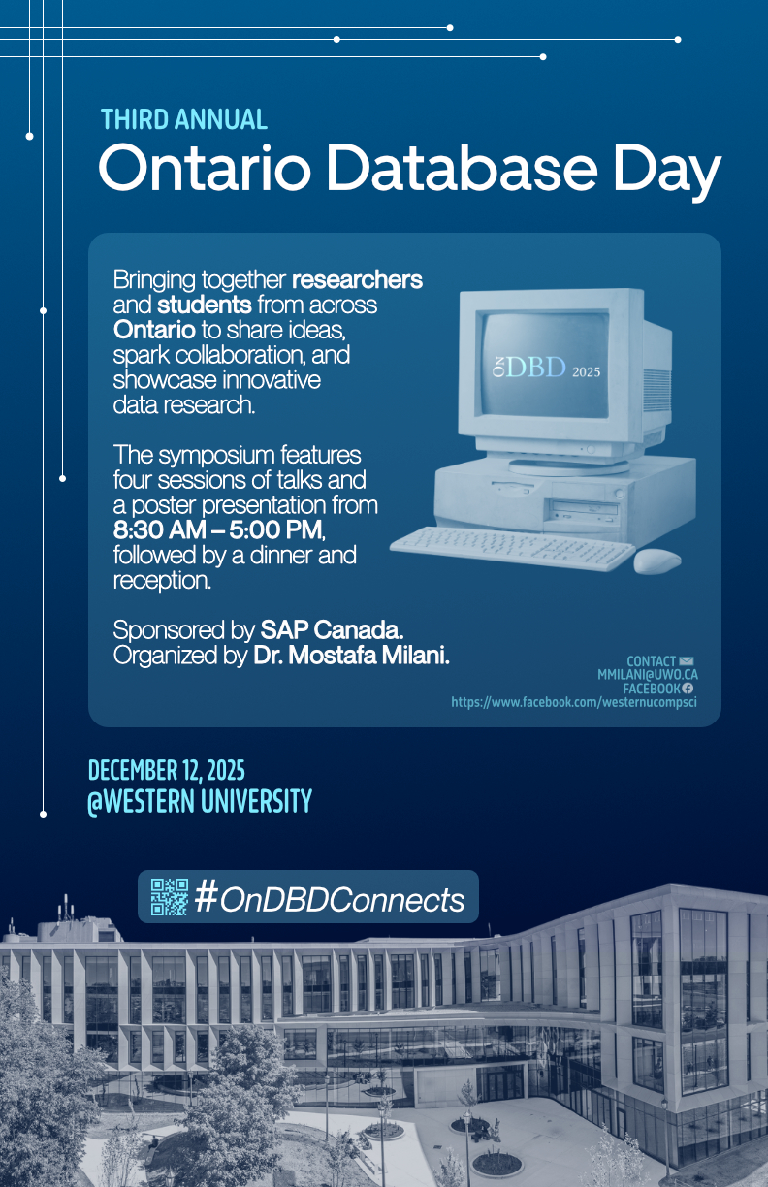
Slide 130 of 160
Notes:
https://cs1033.gaul.csd.uwo.ca/~snarang9/posterassign/snarang9_poster.jpg

Slide 132
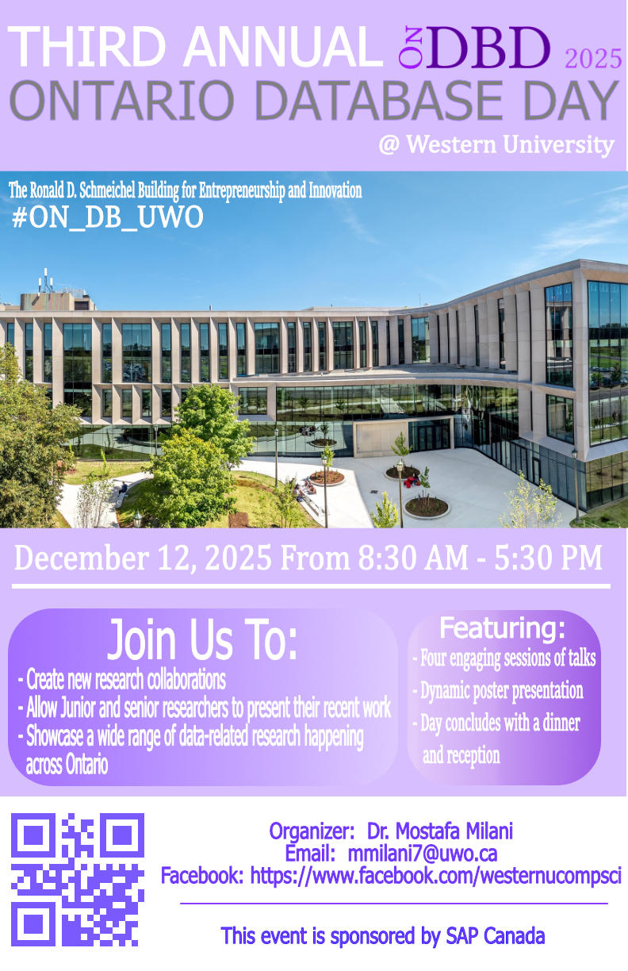
Slide 131 of 160
Notes:
https://cs1033.gaul.csd.uwo.ca/~snarolia/posterassign/snarolia_poster.jpg

Slide 133

Slide 132 of 160
Notes:
https://cs1033.gaul.csd.uwo.ca/~snguy64/posterassign/snguy64_poster.jpg

Slide 134

Slide 133 of 160
Notes:
https://cs1033.gaul.csd.uwo.ca/~spark753/posterassign/spark753_poster.jpg

Slide 135

Slide 134 of 160
Notes:
https://cs1033.gaul.csd.uwo.ca/~sperei63/posterassign/sperei63_poster.jpg

Slide 136

Slide 135 of 160
Notes:
https://cs1033.gaul.csd.uwo.ca/~spetroz3/posterassign/spetroz3_poster.jpg

Slide 137

Slide 136 of 160
Notes:
https://cs1033.gaul.csd.uwo.ca/~sprabak4/posterassign/sprabak4_poster.jpg

Slide 138

Slide 137 of 160
Notes:
https://cs1033.gaul.csd.uwo.ca/~spreete/posterassign/spreete_poster.jpg

Slide 139

Slide 138 of 160
Notes:
https://cs1033.gaul.csd.uwo.ca/~spujari2/posterassign/spujari2_poster.jpg

Slide 140

Slide 139 of 160
Notes:
https://cs1033.gaul.csd.uwo.ca/~sqian57/posterassign/sqian57_poster.jpg

Slide 141

Slide 140 of 160
Notes:
https://cs1033.gaul.csd.uwo.ca/~srocchet/posterassign/srocchet_poster.jpg

Slide 142

Slide 141 of 160
Notes:
https://cs1033.gaul.csd.uwo.ca/~sroopla/posterassign/sroopla_poster.jpg

Slide 143
Slide 142 of 160
Notes:
https://cs1033.gaul.csd.uwo.ca/~ssacks2/posterassign/ssacks2_poster.jpg

Slide 144

Slide 143 of 160
Notes:
https://cs1033.gaul.csd.uwo.ca/~ssajja24/posterassign/ssajja24_poster.jpg

Slide 145

Slide 144 of 160
Notes:
https://cs1033.gaul.csd.uwo.ca/~ssalma8/posterassign/ssalma8_poster.jpg

Slide 146

Slide 145 of 160
Notes:
https://cs1033.gaul.csd.uwo.ca/~ssandrin/posterassign/ssandrin_poster.jpg

Slide 147

Slide 146 of 160
Notes:
https://cs1033.gaul.csd.uwo.ca/~ssehl/posterassign/ssehl_poster.jpg

Slide 148

Slide 147 of 160
Notes:
https://cs1033.gaul.csd.uwo.ca/~ssemple2/posterassign/ssemple2_poster.jpg

Slide 149

Slide 148 of 160
Notes:
https://cs1033.gaul.csd.uwo.ca/~ssilve48/posterassign/ssilve48_poster.jpg

Slide 150

Slide 149 of 160
Notes:
https://cs1033.gaul.csd.uwo.ca/~ssimran5/posterassign/ssimran5_poster.jpg

Slide 151

Slide 150 of 160
Notes:
https://cs1033.gaul.csd.uwo.ca/~ssing938/posterassign/ssing938_poster.jpg

Slide 152

Slide 151 of 160
Notes:
https://cs1033.gaul.csd.uwo.ca/~ssing943/posterassign/ssing943_poster.jpg

Slide 153

Slide 152 of 160
Notes:
https://cs1033.gaul.csd.uwo.ca/~ssivar7/posterassign/ssivar7_poster.jpg

Slide 154

Slide 153 of 160
Notes:
https://cs1033.gaul.csd.uwo.ca/~sskinn25/posterassign/sskinn25_poster.jpg

Slide 155
Slide 154 of 160
Notes:
https://cs1033.gaul.csd.uwo.ca/~sslaven3/posterassign/sslaven3_poster.jpg

Slide 156

Slide 155 of 160
Notes:
https://cs1033.gaul.csd.uwo.ca/~sstein26/posterassign/sstein26_poster.jpg

Slide 157

Slide 156 of 160
Notes:
https://cs1033.gaul.csd.uwo.ca/~stang379/posterassign/stang379_poster.jpg

Slide 158
Slide 157 of 160
Notes:
https://cs1033.gaul.csd.uwo.ca/~stayl326/posterassign/stayl326_poster.jpg

Slide 159

Slide 158 of 160
Notes:
https://cs1033.gaul.csd.uwo.ca/~sthorne9/posterassign/sthorne9_poster.jpg

Slide 160

Slide 159 of 160
Notes:
https://cs1033.gaul.csd.uwo.ca/~stobar/posterassign/stobar_poster.jpg

Slide 161

Slide 160 of 160
Notes:
https://cs1033.gaul.csd.uwo.ca/~swambua/posterassign/swambua_poster.jpg

