Slide 1
TOP PICKS
COMPSCI 1033A - FALL 2025

Slide 2

Notes:
https://cs1033.gaul.csd.uwo.ca/~aadata/posterassign/aadata_poster.jpg

Slide 3

Notes:
https://cs1033.gaul.csd.uwo.ca/~aagost/posterassign/aagost_poster.jpg

Slide 4

Notes:
https://cs1033.gaul.csd.uwo.ca/~aalfarr3/posterassign/aalfarr3_poster.jpg

Slide 5

Notes:
https://cs1033.gaul.csd.uwo.ca/~achong66/posterassign/achong66_poster.jpg

Slide 6

Notes:
https://cs1033.gaul.csd.uwo.ca/~ajimen3/posterassign/ajimen3_poster.jpg

Slide 7

Notes:
https://cs1033.gaul.csd.uwo.ca/~akang64/posterassign/akang64_poster.jpg

Slide 8

Notes:
https://cs1033.gaul.csd.uwo.ca/~aliu432/posterassign/aliu432_poster.jpg

Slide 9

Notes:
https://cs1033.gaul.csd.uwo.ca/~amcken65/posterassign/amcken65_poster.jpg

Slide 10

Notes:
https://cs1033.gaul.csd.uwo.ca/~apezhman/posterassign/apezhman_poster.jpg

Slide 11

Notes:
https://cs1033.gaul.csd.uwo.ca/~aroger72/posterassign/aroger72_poster.jpg

Slide 12
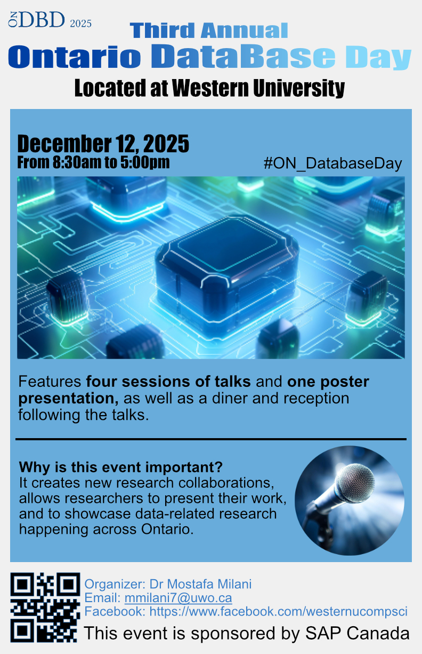
Notes:
https://cs1033.gaul.csd.uwo.ca/~aroger82/posterassign/aroger82_poster.jpg

Slide 13

Notes:
https://cs1033.gaul.csd.uwo.ca/~aspagno4/posterassign/aspagno4_poster.jpg

Slide 14

Notes:
https://cs1033.gaul.csd.uwo.ca/~bszyc/posterassign/bszyc_poster.jpg

Slide 15

Notes:
https://cs1033.gaul.csd.uwo.ca/~ccha92/posterassign/ccha92_poster.jpg

Slide 16

Notes:
https://cs1033.gaul.csd.uwo.ca/~cdeligna/posterassign/cdeligna_poster.jpg

Slide 17

Notes:
https://cs1033.gaul.csd.uwo.ca/~cguo264/posterassign/cguo264_poster.jpg

Slide 18

Notes:
https://cs1033.gaul.csd.uwo.ca/~cshih33/posterassign/cshih33_poster.jpg

Slide 19

Notes:
https://cs1033.gaul.csd.uwo.ca/~dparr2/posterassign/dparr2_poster.jpg

Slide 20

Notes:
https://cs1033.gaul.csd.uwo.ca/~dpate846/posterassign/dpate846_poster.jpg

Slide 21

Notes:
https://cs1033.gaul.csd.uwo.ca/~dpelleg2/posterassign/dpelleg2_poster.jpg

Slide 22

Notes:
https://cs1033.gaul.csd.uwo.ca/~dyang325/posterassign/dyang325_poster.jpg

Slide 23

Notes:
https://cs1033.gaul.csd.uwo.ca/~egroves2/posterassign/egroves2_poster.jpg

Slide 24

Notes:
https://cs1033.gaul.csd.uwo.ca/~enagy22/posterassign/enagy22_poster.jpg

Slide 25

Notes:
https://cs1033.gaul.csd.uwo.ca/~eporte9/posterassign/eporte9_poster.jpg

Slide 26

Notes:
https://cs1033.gaul.csd.uwo.ca/~eyen/posterassign/eyen_poster.jpg

Slide 27

Notes:
https://cs1033.gaul.csd.uwo.ca/~gcui5/posterassign/gcui5_poster.jpg

Slide 28

Notes:
https://cs1033.gaul.csd.uwo.ca/~hoh57/posterassign/hoh57_poster.jpg

Slide 29

Notes:
https://cs1033.gaul.csd.uwo.ca/~hqures32/posterassign/hqures32_poster.jpg

Slide 30

Notes:
https://cs1033.gaul.csd.uwo.ca/~imelo/posterassign/imelo_poster.jpg

Slide 31

Notes:
https://cs1033.gaul.csd.uwo.ca/~iparamje/posterassign/iparamje_poster.jpg

Slide 32

Notes:
https://cs1033.gaul.csd.uwo.ca/~iyi4/posterassign/iyi4_poster.jpg

Slide 33

Notes:
https://cs1033.gaul.csd.uwo.ca/~jbalbou/posterassign/jbalbou_poster.jpg

Slide 34

Notes:
https://cs1033.gaul.csd.uwo.ca/~jdermit2/posterassign/jdermit2_poster.jpg

Slide 35

Notes:
https://cs1033.gaul.csd.uwo.ca/~jgoulter/posterassign/jgoulter_poster.jpg

Slide 36

Notes:
https://cs1033.gaul.csd.uwo.ca/~jkim3226/posterassign/jkim3226_poster.jpg

Slide 37

Notes:
https://cs1033.gaul.csd.uwo.ca/~jli4963/posterassign/jli4963_poster.jpg

Slide 38

Notes:
https://cs1033.gaul.csd.uwo.ca/~jmehra2/posterassign/jmehra2_poster.jpg

Slide 39
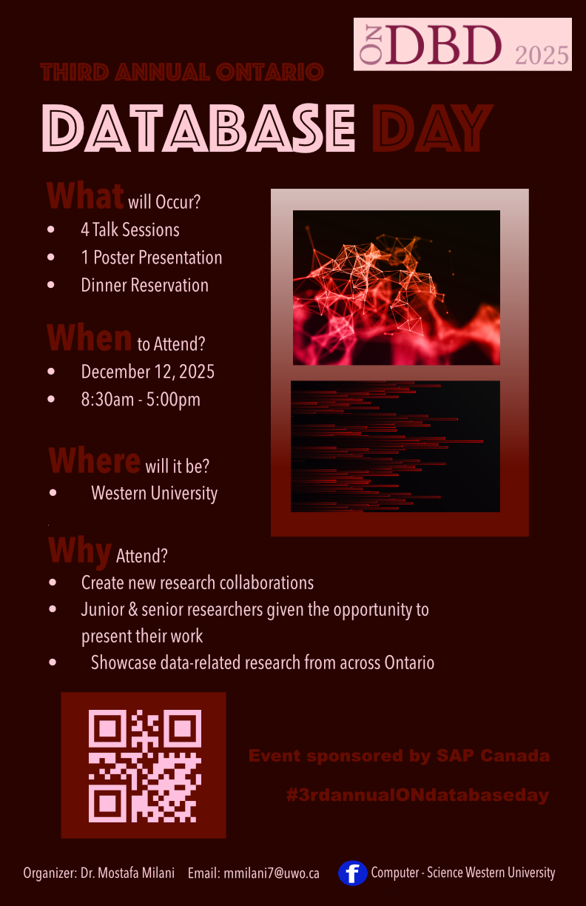
Notes:
https://cs1033.gaul.csd.uwo.ca/~jstefan6/posterassign/jstefan6_poster.jpg

Slide 40

Notes:
https://cs1033.gaul.csd.uwo.ca/~jwierda/posterassign/jwierda_poster.jpg

Slide 41

Notes:
https://cs1033.gaul.csd.uwo.ca/~jxu2272/posterassign/jxu2272_poster.jpg

Slide 42

Notes:
https://cs1033.gaul.csd.uwo.ca/~kballer/posterassign/kballer_poster.jpg

Slide 43

Notes:
https://cs1033.gaul.csd.uwo.ca/~kdean29/posterassign/kdean29_poster.jpg

Slide 44
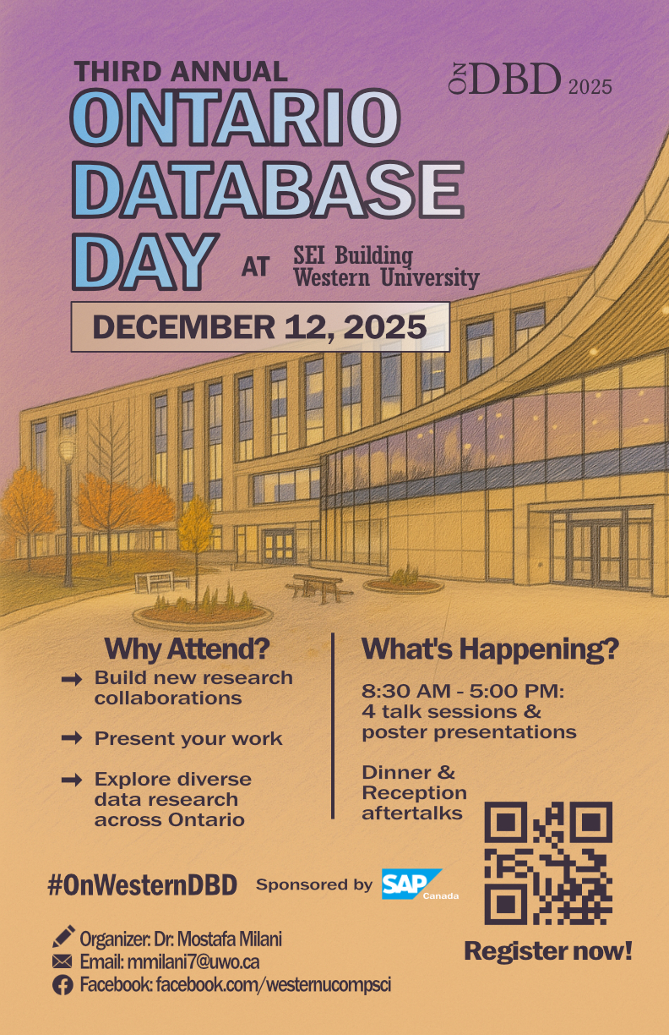
Notes:
https://cs1033.gaul.csd.uwo.ca/~klee963/posterassign/klee963_poster.jpg

Slide 45

Notes:
https://cs1033.gaul.csd.uwo.ca/~lchen974/posterassign/lchen974_poster.jpg

Slide 46

Notes:
https://cs1033.gaul.csd.uwo.ca/~lli2242/posterassign/lli2242_poster.jpg

Slide 47

Notes:
https://cs1033.gaul.csd.uwo.ca/~lwojcik2/posterassign/lwojcik2_poster.jpg

Slide 48

Notes:
https://cs1033.gaul.csd.uwo.ca/~lyoveti/posterassign/lyoveti_poster.jpg

Slide 49

Notes:
https://cs1033.gaul.csd.uwo.ca/~mallis4/posterassign/mallis4_poster.jpg

Slide 50

Notes:
https://cs1033.gaul.csd.uwo.ca/~mbake33/posterassign/mbake33_poster.jpg

Slide 51

Notes:
https://cs1033.gaul.csd.uwo.ca/~mbarkov/posterassign/mbarkov_poster.jpg

Slide 52

Notes:
https://cs1033.gaul.csd.uwo.ca/~mlebla68/posterassign/mlebla68_poster.jpg

Slide 53

Notes:
https://cs1033.gaul.csd.uwo.ca/~mlewis89/posterassign/mlewis89_poster.jpg

Slide 54

Notes:
https://cs1033.gaul.csd.uwo.ca/~mtariq67/posterassign/mtariq67_poster.jpg

Slide 55

Notes:
https://cs1033.gaul.csd.uwo.ca/~oonyegb/posterassign/oonyegb_poster.jpg

Slide 56

Notes:
https://cs1033.gaul.csd.uwo.ca/~rgadassi/posterassign/rgadassi_poster.jpg

Slide 57

Notes:
https://cs1033.gaul.csd.uwo.ca/~rraisi/posterassign/rraisi_poster.jpg

Slide 58

Notes:
https://cs1033.gaul.csd.uwo.ca/~rstock2/posterassign/rstock2_poster.jpg

Slide 59

Notes:
https://cs1033.gaul.csd.uwo.ca/~ryang377/posterassign/ryang377_poster.jpg

Slide 60

Notes:
https://cs1033.gaul.csd.uwo.ca/~rzhan886/posterassign/rzhan886_poster.jpg

Slide 61

Notes:
https://cs1033.gaul.csd.uwo.ca/~sbutche/posterassign/sbutche_poster.jpg

Slide 62

Notes:
https://cs1033.gaul.csd.uwo.ca/~scraig57/posterassign/scraig57_poster.jpg

Slide 63

Notes:
https://cs1033.gaul.csd.uwo.ca/~sgao376/posterassign/sgao376_poster.jpg

Slide 64

Notes:
https://cs1033.gaul.csd.uwo.ca/~she393/posterassign/she393_poster.jpg

Slide 65

Notes:
https://cs1033.gaul.csd.uwo.ca/~sjun29/posterassign/sjun29_poster.jpg

Slide 66

Notes:
https://cs1033.gaul.csd.uwo.ca/~skassim8/posterassign/skassim8_poster.jpg

Slide 67

Notes:
https://cs1033.gaul.csd.uwo.ca/~spark753/posterassign/spark753_poster.jpg

Slide 68

Notes:
https://cs1033.gaul.csd.uwo.ca/~spujari2/posterassign/spujari2_poster.jpg

Slide 69

Notes:
https://cs1033.gaul.csd.uwo.ca/~sroopla/posterassign/sroopla_poster.jpg

Slide 70

Notes:
https://cs1033.gaul.csd.uwo.ca/~ssajja24/posterassign/ssajja24_poster.jpg

Slide 71

Notes:
https://cs1033.gaul.csd.uwo.ca/~ssing938/posterassign/ssing938_poster.jpg

Slide 72

Notes:
https://cs1033.gaul.csd.uwo.ca/~sthorne9/posterassign/sthorne9_poster.jpg

Slide 73

Notes:
https://cs1033.gaul.csd.uwo.ca/~swan2452/posterassign/swan2452_poster.jpg

Slide 74

Notes:
https://cs1033.gaul.csd.uwo.ca/~switty2/posterassign/switty2_poster.jpg

Slide 75

Notes:
https://cs1033.gaul.csd.uwo.ca/~wlin297/posterassign/wlin297_poster.jpg

Slide 76

Slide 72 of 160
Notes:
https://cs1033.gaul.csd.uwo.ca/~xyang862/posterassign/xyang862_poster.jpg

Slide 77

Notes:
https://cs1033.gaul.csd.uwo.ca/~xzhu547/posterassign/xzhu547_poster.jpg

Slide 78

Notes:
https://cs1033.gaul.csd.uwo.ca/~yche4334/posterassign/yche4334_poster.jpg

Slide 79

Slide 82 of 160
Notes:
https://cs1033.gaul.csd.uwo.ca/~ykishant/posterassign/ykishant_poster.jpg

Slide 80

Notes:
https://cs1033.gaul.csd.uwo.ca/~ysun2534/posterassign/ysun2534_poster.jpg

Slide 81

Notes:
https://cs1033.gaul.csd.uwo.ca/~zliu2864/posterassign/zliu2864_poster.jpg

