Slide 1
POSTER SHOW Group 1

Slide 2
Slide 1 of 160
Notes:
https://cs1033.gaul.csd.uwo.ca/~aadams96/posterassign/aadams96_poster.jpg

Slide 3

Slide 2 of 160
Notes:
https://cs1033.gaul.csd.uwo.ca/~aagarw86/posterassign/aagarw86_poster.jpg

Slide 4
Slide 3 of 160
Notes:
https://cs1033.gaul.csd.uwo.ca/~aalexa83/posterassign/aalexa83_poster.jpg

Slide 5

Slide 4 of 160
Notes:
https://cs1033.gaul.csd.uwo.ca/~aalzayed/posterassign/aalzayed_poster.jpg

Slide 6

Slide 5 of 160
Notes:
https://cs1033.gaul.csd.uwo.ca/~aaziz85/posterassign/aaziz85_poster.jpg

Slide 7
Slide 6 of 160
Notes:
https://cs1033.gaul.csd.uwo.ca/~abacho/posterassign/abacho_poster.jpg

Slide 8
Slide 7 of 160
Notes:
https://cs1033.gaul.csd.uwo.ca/~abal43/posterassign/abal43_poster.jpg

Slide 9

Slide 8 of 160
Notes:
https://cs1033.gaul.csd.uwo.ca/~abenbihy/posterassign/abenbihy_poster.jpg

Slide 10

Slide 9 of 160
Notes:
https://cs1033.gaul.csd.uwo.ca/~abenlol/posterassign/abenlol_poster.jpg

Slide 11

Slide 10 of 160
Notes:
https://cs1033.gaul.csd.uwo.ca/~abombar2/posterassign/abombar2_poster.jpg

Slide 12

Slide 11 of 160
Notes:
https://cs1033.gaul.csd.uwo.ca/~abot2/posterassign/abot2_poster.jpg

Slide 13

Slide 12 of 160
Notes:
https://cs1033.gaul.csd.uwo.ca/~abrophy3/posterassign/abrophy3_poster.jpg

Slide 14

Slide 13 of 160
Notes:
https://cs1033.gaul.csd.uwo.ca/~acakic/posterassign/acakic_poster.jpg

Slide 15

Slide 14 of 160
Notes:
https://cs1033.gaul.csd.uwo.ca/~acancel4/posterassign/acancel4_poster.jpg

Slide 16

Slide 15 of 160
Notes:
https://cs1033.gaul.csd.uwo.ca/~acardey/posterassign/acardey_poster.jpg

Slide 17
Slide 16 of 160
Notes:
https://cs1033.gaul.csd.uwo.ca/~acheh2/posterassign/acheh2_poster.jpg

Slide 18

Slide 17 of 160
Notes:
https://cs1033.gaul.csd.uwo.ca/~acorby/posterassign/acorby_poster.jpg

Slide 19

Slide 18 of 160
Notes:
https://cs1033.gaul.csd.uwo.ca/~adecosi/posterassign/adecosi_poster.jpg

Slide 20
Slide 19 of 160
Notes:
https://cs1033.gaul.csd.uwo.ca/~adipasq3/posterassign/adipasq3_poster.jpg

Slide 21

Slide 20 of 160
Notes:
https://cs1033.gaul.csd.uwo.ca/~adirien/posterassign/adirien_poster.jpg

Slide 22

Slide 21 of 160
Notes:
https://cs1033.gaul.csd.uwo.ca/~adoria8/posterassign/adoria8_poster.jpg

Slide 23

Slide 22 of 160
Notes:
https://cs1033.gaul.csd.uwo.ca/~aelhadar/posterassign/aelhadar_poster.jpg

Slide 24
Slide 23 of 160
Notes:
https://cs1033.gaul.csd.uwo.ca/~aelham/posterassign/aelham_poster.jpg

Slide 25

Slide 24 of 160
Notes:
https://cs1033.gaul.csd.uwo.ca/~aelhass3/posterassign/aelhass3_poster.jpg

Slide 26
Slide 25 of 160
Notes:
https://cs1033.gaul.csd.uwo.ca/~aeltata/posterassign/aeltata_poster.jpg

Slide 27
Slide 26 of 160
Notes:
https://cs1033.gaul.csd.uwo.ca/~aescoto5/posterassign/aescoto5_poster.jpg

Slide 28

Slide 27 of 160
Notes:
https://cs1033.gaul.csd.uwo.ca/~agarston/posterassign/agarston_poster.jpg

Slide 29

Slide 28 of 160
Notes:
https://cs1033.gaul.csd.uwo.ca/~agautha2/posterassign/agautha2_poster.jpg

Slide 30
Slide 29 of 160
Notes:
https://cs1033.gaul.csd.uwo.ca/~agupt447/posterassign/agupt447_poster.jpg

Slide 31

Slide 30 of 160
Notes:
https://cs1033.gaul.csd.uwo.ca/~ahudani7/posterassign/ahudani7_poster.jpg

Slide 32

Slide 31 of 160
Notes:
https://cs1033.gaul.csd.uwo.ca/~ahwang25/posterassign/ahwang25_poster.jpg

Slide 33
Slide 32 of 160
Notes:
https://cs1033.gaul.csd.uwo.ca/~aipwansh/posterassign/aipwansh_poster.jpg

Slide 34

Slide 33 of 160
Notes:
https://cs1033.gaul.csd.uwo.ca/~aiqbal95/posterassign/aiqbal95_poster.jpg

Slide 35
Slide 34 of 160
Notes:
https://cs1033.gaul.csd.uwo.ca/~aizedonm/posterassign/aizedonm_poster.jpg

Slide 36

Slide 35 of 160
Notes:
https://cs1033.gaul.csd.uwo.ca/~ajani22/posterassign/ajani22_poster.jpg

Slide 37
Slide 36 of 160
Notes:
https://cs1033.gaul.csd.uwo.ca/~ajanmo5/posterassign/ajanmo5_poster.jpg

Slide 38

Slide 37 of 160
Notes:
https://cs1033.gaul.csd.uwo.ca/~ajone295/posterassign/ajone295_poster.jpg

Slide 39
Slide 38 of 160
Notes:
https://cs1033.gaul.csd.uwo.ca/~akakouro/posterassign/akakouro_poster.jpg

Slide 40

Slide 39 of 160
Notes:
https://cs1033.gaul.csd.uwo.ca/~akarimif/posterassign/akarimif_poster.jpg

Slide 41
Slide 40 of 160
Notes:
https://cs1033.gaul.csd.uwo.ca/~akavian2/posterassign/akavian2_poster.jpg

Slide 42

Slide 41 of 160
Notes:
https://cs1033.gaul.csd.uwo.ca/~akha592/posterassign/akha592_poster.jpg

Slide 43

Slide 42 of 160
Notes:
https://cs1033.gaul.csd.uwo.ca/~aladhe/posterassign/aladhe_poster.jpg

Slide 44

Slide 43 of 160
Notes:
https://cs1033.gaul.csd.uwo.ca/~aliu562/posterassign/aliu562_poster.jpg

Slide 45

Slide 44 of 160
Notes:
https://cs1033.gaul.csd.uwo.ca/~aliu565/posterassign/aliu565_poster.jpg

Slide 46

Slide 45 of 160
Notes:
https://cs1033.gaul.csd.uwo.ca/~aliu585/posterassign/aliu585_poster.jpg

Slide 47

Slide 46 of 160
Notes:
https://cs1033.gaul.csd.uwo.ca/~alloyd56/posterassign/alloyd56_poster.jpg

Slide 48

Slide 47 of 160
Notes:
https://cs1033.gaul.csd.uwo.ca/~aluong33/posterassign/aluong33_poster.jpg

Slide 49
Slide 48 of 160
Notes:
https://cs1033.gaul.csd.uwo.ca/~amahar25/posterassign/amahar25_poster.jpg

Slide 50

Slide 49 of 160
Notes:
https://cs1033.gaul.csd.uwo.ca/~amarzil/posterassign/amarzil_poster.jpg

Slide 51
Slide 50 of 160
Notes:
https://cs1033.gaul.csd.uwo.ca/~amclar4/posterassign/amclar4_poster.jpg

Slide 52

Slide 51 of 160
Notes:
https://cs1033.gaul.csd.uwo.ca/~ameyer52/posterassign/ameyer52_poster.jpg

Slide 53

Slide 52 of 160
Notes:
https://cs1033.gaul.csd.uwo.ca/~amir28/posterassign/amir28_poster.jpg

Slide 54

Slide 53 of 160
Notes:
https://cs1033.gaul.csd.uwo.ca/~amitc55/posterassign/amitc55_poster.jpg

Slide 55

Slide 54 of 160
Notes:
https://cs1033.gaul.csd.uwo.ca/~amoha722/posterassign/amoha722_poster.jpg

Slide 56
Slide 55 of 160
Notes:
https://cs1033.gaul.csd.uwo.ca/~amojarra/posterassign/amojarra_poster.jpg

Slide 57

Slide 56 of 160
Notes:
https://cs1033.gaul.csd.uwo.ca/~anearin3/posterassign/anearin3_poster.jpg

Slide 58

Slide 57 of 160
Notes:
https://cs1033.gaul.csd.uwo.ca/~aniski2/posterassign/aniski2_poster.jpg

Slide 59

Slide 58 of 160
Notes:
https://cs1033.gaul.csd.uwo.ca/~aosman87/posterassign/aosman87_poster.jpg

Slide 60

Slide 59 of 160
Notes:
https://cs1033.gaul.csd.uwo.ca/~apalles2/posterassign/apalles2_poster.jpg

Slide 61

Slide 60 of 160
Notes:
https://cs1033.gaul.csd.uwo.ca/~apandy25/posterassign/apandy25_poster.jpg

Slide 62

Slide 61 of 160
Notes:
https://cs1033.gaul.csd.uwo.ca/~aparial/posterassign/aparial_poster.jpg

Slide 63

Slide 62 of 160
Notes:
https://cs1033.gaul.csd.uwo.ca/~apatara/posterassign/apatara_poster.jpg

Slide 64

Slide 63 of 160
Notes:
https://cs1033.gaul.csd.uwo.ca/~aphan29/posterassign/aphan29_poster.jpg

Slide 65

Slide 64 of 160
Notes:
https://cs1033.gaul.csd.uwo.ca/~apolan/posterassign/apolan_poster.jpg

Slide 66

Slide 65 of 160
Notes:
https://cs1033.gaul.csd.uwo.ca/~arastgar/posterassign/arastgar_poster.jpg

Slide 67

Slide 66 of 160
Notes:
https://cs1033.gaul.csd.uwo.ca/~areyno43/posterassign/areyno43_poster.jpg

Slide 68

Slide 67 of 160
Notes:
https://cs1033.gaul.csd.uwo.ca/~arumford/posterassign/arumford_poster.jpg

Slide 69

Slide 68 of 160
Notes:
https://cs1033.gaul.csd.uwo.ca/~arusnak/posterassign/arusnak_poster.jpg

Slide 70
Slide 69 of 160
Notes:
https://cs1033.gaul.csd.uwo.ca/~asalter6/posterassign/asalter6_poster.jpg

Slide 71

Slide 70 of 160
Notes:
https://cs1033.gaul.csd.uwo.ca/~asarats2/posterassign/asarats2_poster.jpg

Slide 72

Slide 71 of 160
Notes:
https://cs1033.gaul.csd.uwo.ca/~ascot254/posterassign/ascot254_poster.jpg

Slide 73

Slide 72 of 160
Notes:
https://cs1033.gaul.csd.uwo.ca/~asegal22/posterassign/asegal22_poster.jpg

Slide 74

Slide 73 of 160
Notes:
https://cs1033.gaul.csd.uwo.ca/~aseto25/posterassign/aseto25_poster.jpg

Slide 75

Slide 74 of 160
Notes:
https://cs1033.gaul.csd.uwo.ca/~ashai83/posterassign/ashai83_poster.jpg

Slide 76
Slide 75 of 160
Notes:
https://cs1033.gaul.csd.uwo.ca/~ashar823/posterassign/ashar823_poster.jpg

Slide 77

Slide 76 of 160
Notes:
https://cs1033.gaul.csd.uwo.ca/~ashi59/posterassign/ashi59_poster.jpg

Slide 78

Slide 77 of 160
Notes:
https://cs1033.gaul.csd.uwo.ca/~ashvedov/posterassign/ashvedov_poster.jpg

Slide 79

Slide 78 of 160
Notes:
https://cs1033.gaul.csd.uwo.ca/~asidd229/posterassign/asidd229_poster.jpg

Slide 80

Slide 79 of 160
Notes:
https://cs1033.gaul.csd.uwo.ca/~asidd56/posterassign/asidd56_poster.jpg

Slide 81

Slide 80 of 160
Notes:
https://cs1033.gaul.csd.uwo.ca/~asigurd4/posterassign/asigurd4_poster.jpg

Slide 82

Slide 81 of 160
Notes:
https://cs1033.gaul.csd.uwo.ca/~asilva47/posterassign/asilva47_poster.jpg

Slide 83

Slide 82 of 160
Notes:
https://cs1033.gaul.csd.uwo.ca/~asin93/posterassign/asin93_poster.jpg

Slide 84

Slide 83 of 160
Notes:
https://cs1033.gaul.csd.uwo.ca/~asindhwa/posterassign/asindhwa_poster.jpg

Slide 85

Slide 84 of 160
Notes:
https://cs1033.gaul.csd.uwo.ca/~astan3/posterassign/astan3_poster.jpg

Slide 86
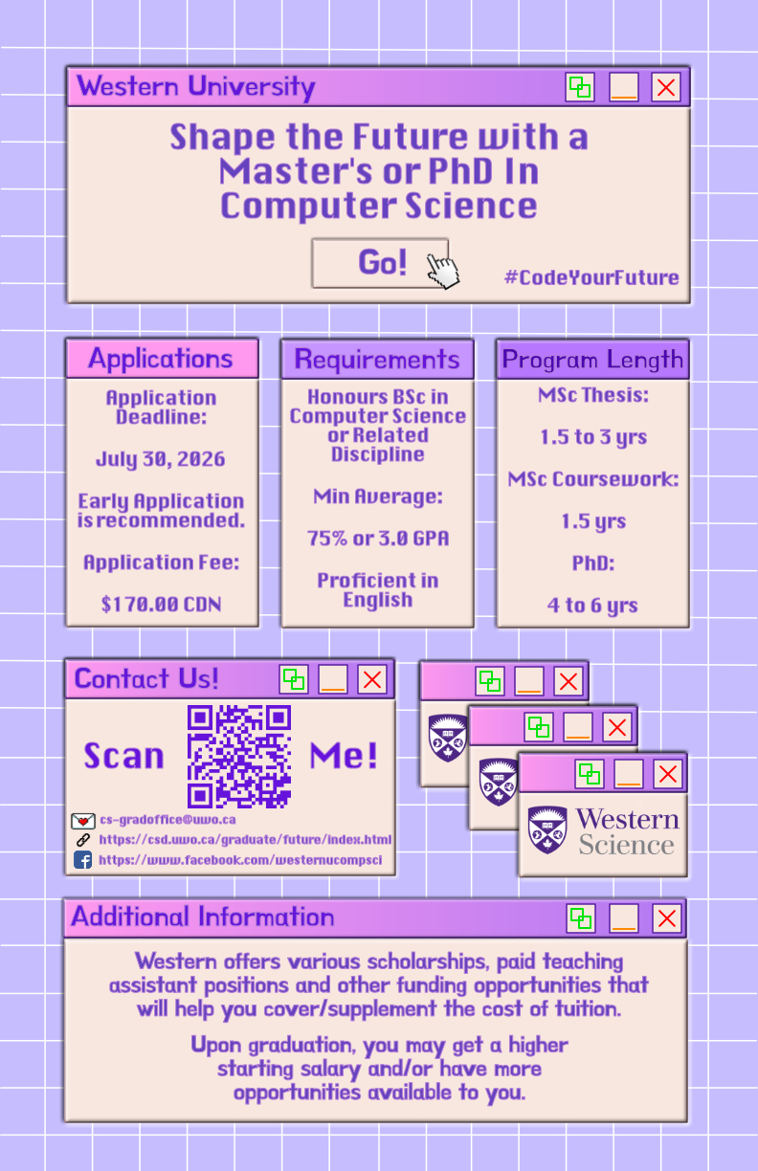
Slide 85 of 160
Notes:
https://cs1033.gaul.csd.uwo.ca/~atilley5/posterassign/atilley5_poster.jpg

Slide 87

Slide 86 of 160
Notes:
https://cs1033.gaul.csd.uwo.ca/~atolent4/posterassign/atolent4_poster.jpg

Slide 88

Slide 87 of 160
Notes:
https://cs1033.gaul.csd.uwo.ca/~atonakan/posterassign/atonakan_poster.jpg

Slide 89

Slide 88 of 160
Notes:
https://cs1033.gaul.csd.uwo.ca/~aumar8/posterassign/aumar8_poster.jpg

Slide 90

Slide 89 of 160
Notes:
https://cs1033.gaul.csd.uwo.ca/~avanloo2/posterassign/avanloo2_poster.jpg

Slide 91

Slide 90 of 160
Notes:
https://cs1033.gaul.csd.uwo.ca/~avarao3/posterassign/avarao3_poster.jpg

Slide 92

Slide 91 of 160
Notes:
https://cs1033.gaul.csd.uwo.ca/~awahaj/posterassign/awahaj_poster.jpg

Slide 93

Slide 92 of 160
Notes:
https://cs1033.gaul.csd.uwo.ca/~awang723/posterassign/awang723_poster.jpg

Slide 94

Slide 93 of 160
Notes:
https://cs1033.gaul.csd.uwo.ca/~awinte5/posterassign/awinte5_poster.jpg

Slide 95

Slide 94 of 160
Notes:
https://cs1033.gaul.csd.uwo.ca/~awu426/posterassign/awu426_poster.jpg

Slide 96

Slide 95 of 160
Notes:
https://cs1033.gaul.csd.uwo.ca/~ayoon26/posterassign/ayoon26_poster.jpg

Slide 97

Slide 96 of 160
Notes:
https://cs1033.gaul.csd.uwo.ca/~azeni2/posterassign/azeni2_poster.jpg

Slide 98

Slide 97 of 160
Notes:
https://cs1033.gaul.csd.uwo.ca/~azhan366/posterassign/azhan366_poster.jpg

Slide 99

Slide 98 of 160
Notes:
https://cs1033.gaul.csd.uwo.ca/~azheng82/posterassign/azheng82_poster.jpg

Slide 100

Slide 99 of 160
Notes:
https://cs1033.gaul.csd.uwo.ca/~bakler/posterassign/bakler_poster.jpg

Slide 101

Slide 100 of 160
Notes:
https://cs1033.gaul.csd.uwo.ca/~bangel3/posterassign/bangel3_poster.jpg

Slide 102

Slide 101 of 160
Notes:
https://cs1033.gaul.csd.uwo.ca/~bbeharie/posterassign/bbeharie_poster.jpg

Slide 103

Slide 102 of 160
Notes:
https://cs1033.gaul.csd.uwo.ca/~bberk2/posterassign/bberk2_poster.jpg

Slide 104

Slide 103 of 160
Notes:
https://cs1033.gaul.csd.uwo.ca/~bcoppola/posterassign/bcoppola_poster.jpg

Slide 105

Slide 104 of 160
Notes:
https://cs1033.gaul.csd.uwo.ca/~bdejene4/posterassign/bdejene4_poster.jpg

Slide 106

Slide 105 of 160
Notes:
https://cs1033.gaul.csd.uwo.ca/~bdo5/posterassign/bdo5_poster.jpg

Slide 107

Slide 106 of 160
Notes:
https://cs1033.gaul.csd.uwo.ca/~bforberg/posterassign/bforberg_poster.jpg

Slide 108

Slide 107 of 160
Notes:
https://cs1033.gaul.csd.uwo.ca/~bkatz5/posterassign/bkatz5_poster.jpg

Slide 109
Slide 108 of 160
Notes:
https://cs1033.gaul.csd.uwo.ca/~bliang69/posterassign/bliang69_poster.jpg

Slide 110

Slide 109 of 160
Notes:
https://cs1033.gaul.csd.uwo.ca/~bmacart3/posterassign/bmacart3_poster.jpg

Slide 111

Slide 110 of 160
Notes:
https://cs1033.gaul.csd.uwo.ca/~bmcgeemc/posterassign/bmcgeemc_poster.jpg

Slide 112
Slide 111 of 160
Notes:
https://cs1033.gaul.csd.uwo.ca/~bmerlin/posterassign/bmerlin_poster.jpg

Slide 113
Slide 112 of 160
Notes:
https://cs1033.gaul.csd.uwo.ca/~bnguye97/posterassign/bnguye97_poster.jpg

Slide 114
Slide 113 of 160
Notes:
https://cs1033.gaul.csd.uwo.ca/~bnielse7/posterassign/bnielse7_poster.jpg

Slide 115

Slide 114 of 160
Notes:
https://cs1033.gaul.csd.uwo.ca/~bnosratm/posterassign/bnosratm_poster.jpg

Slide 116

Slide 115 of 160
Notes:
https://cs1033.gaul.csd.uwo.ca/~bpeers/posterassign/bpeers_poster.jpg

Slide 117

Slide 116 of 160
Notes:
https://cs1033.gaul.csd.uwo.ca/~bregan2/posterassign/bregan2_poster.jpg

Slide 118

Slide 117 of 160
Notes:
https://cs1033.gaul.csd.uwo.ca/~broy44/posterassign/broy44_poster.jpg

Slide 119

Slide 118 of 160
Notes:
https://cs1033.gaul.csd.uwo.ca/~bshakir2/posterassign/bshakir2_poster.jpg

Slide 120

Slide 119 of 160
Notes:
https://cs1033.gaul.csd.uwo.ca/~byao42/posterassign/byao42_poster.jpg

Slide 121

Slide 120 of 160
Notes:
https://cs1033.gaul.csd.uwo.ca/~bye56/posterassign/bye56_poster.jpg

Slide 122
Slide 121 of 160
Notes:
https://cs1033.gaul.csd.uwo.ca/~bzhan682/posterassign/bzhan682_poster.jpg

Slide 123
Slide 122 of 160
Notes:
https://cs1033.gaul.csd.uwo.ca/~calborno/posterassign/calborno_poster.jpg

Slide 124

Slide 123 of 160
Notes:
https://cs1033.gaul.csd.uwo.ca/~caninye/posterassign/caninye_poster.jpg

Slide 125

Slide 124 of 160
Notes:
https://cs1033.gaul.csd.uwo.ca/~carmatys/posterassign/carmatys_poster.jpg

Slide 126

Slide 125 of 160
Notes:
https://cs1033.gaul.csd.uwo.ca/~cbenakop/posterassign/cbenakop_poster.jpg

Slide 127

Slide 126 of 160
Notes:
https://cs1033.gaul.csd.uwo.ca/~cchae/posterassign/cchae_poster.jpg

Slide 128

Slide 127 of 160
Notes:
https://cs1033.gaul.csd.uwo.ca/~cche267/posterassign/cche267_poster.jpg

Slide 129

Slide 128 of 160
Notes:
https://cs1033.gaul.csd.uwo.ca/~cchong83/posterassign/cchong83_poster.jpg

Slide 130

Slide 129 of 160
Notes:
https://cs1033.gaul.csd.uwo.ca/~cchong84/posterassign/cchong84_poster.jpg

Slide 131

Slide 130 of 160
Notes:
https://cs1033.gaul.csd.uwo.ca/~cchun248/posterassign/cchun248_poster.jpg

Slide 132

Slide 131 of 160
Notes:
https://cs1033.gaul.csd.uwo.ca/~ccortesb/posterassign/ccortesb_poster.jpg

Slide 133
Slide 132 of 160
Notes:
https://cs1033.gaul.csd.uwo.ca/~ccreed3/posterassign/ccreed3_poster.jpg

Slide 134

Slide 133 of 160
Notes:
https://cs1033.gaul.csd.uwo.ca/~cdistasi/posterassign/cdistasi_poster.jpg

Slide 135

Slide 134 of 160
Notes:
https://cs1033.gaul.csd.uwo.ca/~cdodek2/posterassign/cdodek2_poster.jpg

Slide 136

Slide 135 of 160
Notes:
https://cs1033.gaul.csd.uwo.ca/~cdoyle65/posterassign/cdoyle65_poster.jpg

Slide 137

Slide 136 of 160
Notes:
https://cs1033.gaul.csd.uwo.ca/~ceve3/posterassign/ceve3_poster.jpg

Slide 138

Slide 137 of 160
Notes:
https://cs1033.gaul.csd.uwo.ca/~cge49/posterassign/cge49_poster.jpg

Slide 139

Slide 138 of 160
Notes:
https://cs1033.gaul.csd.uwo.ca/~cgeo/posterassign/cgeo_poster.jpg

Slide 140

Slide 139 of 160
Notes:
https://cs1033.gaul.csd.uwo.ca/~cgilli29/posterassign/cgilli29_poster.jpg

Slide 141
Slide 140 of 160
Notes:
https://cs1033.gaul.csd.uwo.ca/~cgoraya2/posterassign/cgoraya2_poster.jpg

Slide 142

Slide 141 of 160
Notes:
https://cs1033.gaul.csd.uwo.ca/~cheath25/posterassign/cheath25_poster.jpg

Slide 143

Slide 142 of 160
Notes:
https://cs1033.gaul.csd.uwo.ca/~chung64/posterassign/chung64_poster.jpg

Slide 144

Slide 143 of 160
Notes:
https://cs1033.gaul.csd.uwo.ca/~cjohn455/posterassign/cjohn455_poster.jpg

Slide 145
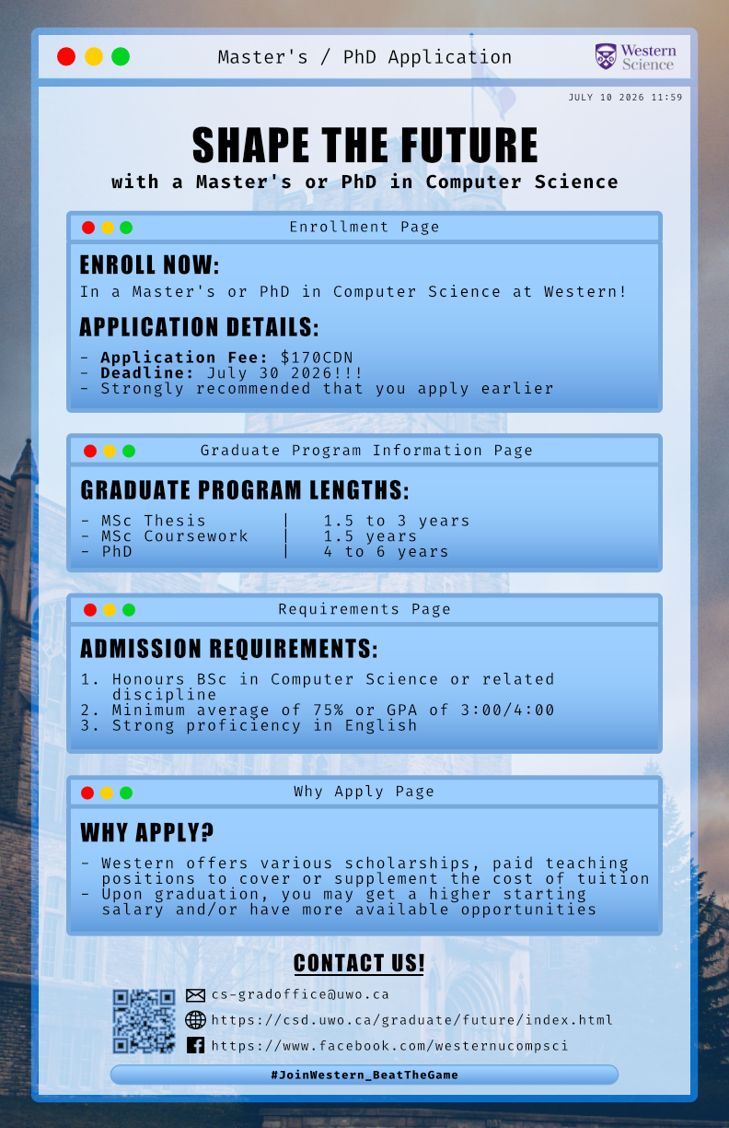
Slide 144 of 160
Notes:
https://cs1033.gaul.csd.uwo.ca/~clee2336/posterassign/clee2336_poster.jpg

Slide 146

Slide 145 of 160
Notes:
https://cs1033.gaul.csd.uwo.ca/~clee2365/posterassign/clee2365_poster.jpg

Slide 147

Slide 146 of 160
Notes:
https://cs1033.gaul.csd.uwo.ca/~cleste/posterassign/cleste_poster.jpg

Slide 148

Slide 147 of 160
Notes:
https://cs1033.gaul.csd.uwo.ca/~cleun376/posterassign/cleun376_poster.jpg

Slide 149

Slide 148 of 160
Notes:
https://cs1033.gaul.csd.uwo.ca/~clo297/posterassign/clo297_poster.jpg

Slide 150

Slide 149 of 160
Notes:
https://cs1033.gaul.csd.uwo.ca/~cmacd297/posterassign/cmacd297_poster.jpg

Slide 151

Slide 150 of 160
Notes:
https://cs1033.gaul.csd.uwo.ca/~cmacki58/posterassign/cmacki58_poster.jpg

Slide 152

Slide 151 of 160
Notes:
https://cs1033.gaul.csd.uwo.ca/~cmaki4/posterassign/cmaki4_poster.jpg

Slide 153
Slide 152 of 160
Notes:
https://cs1033.gaul.csd.uwo.ca/~cmasse5/posterassign/cmasse5_poster.jpg

Slide 154

Slide 153 of 160
Notes:
https://cs1033.gaul.csd.uwo.ca/~cmatth58/posterassign/cmatth58_poster.jpg

Slide 155
Slide 154 of 160
Notes:
https://cs1033.gaul.csd.uwo.ca/~cmazzuca/posterassign/cmazzuca_poster.jpg

Slide 156
Slide 155 of 160
Notes:
https://cs1033.gaul.csd.uwo.ca/~cmcdo44/posterassign/cmcdo44_poster.jpg

Slide 157

Slide 156 of 160
Notes:
https://cs1033.gaul.csd.uwo.ca/~cmcgil3/posterassign/cmcgil3_poster.jpg

Slide 158

Slide 157 of 160
Notes:
https://cs1033.gaul.csd.uwo.ca/~cmcmil28/posterassign/cmcmil28_poster.jpg

Slide 159

Slide 158 of 160
Notes:
https://cs1033.gaul.csd.uwo.ca/~cmcnama8/posterassign/cmcnama8_poster.jpg

Slide 160

Slide 159 of 160
Notes:
https://cs1033.gaul.csd.uwo.ca/~cmelbou3/posterassign/cmelbou3_poster.jpg

Slide 161

Slide 160 of 160
Notes:
https://cs1033.gaul.csd.uwo.ca/~cnixon8/posterassign/cnixon8_poster.jpg

