Slide 1
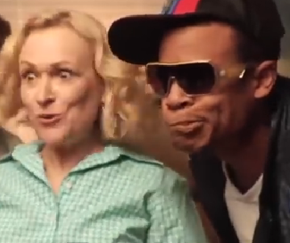
Graphics Continued
Computer Science 1033 – Week 4
“Give a person a fish and you feed them for a day; teach that person to use the Internet and they won't bother you for weeks”.→ Anonymous

Slide 2
Overview of This Week’s Topics
How to hand in Assignment 1
Compression
File types: GIF, JPG and PNG

Slide 3
Reading for this week from our online textbook:
Graphics → Image Formats and Compression Techniques

Slide 4
Handing in the Poster Assignment
Handing in Assignment is 2-part:
Part 1: Uploading to cs1033.gaul.csd.uwo.ca via WinSCP
Part 2: Submitting the links and references via kritik.io
Video of how to hand it in: go to Poster Assignment and there is a video that explains how to hand everything in.

Slide 5
Transferring Files to the World Wide Web
This info is a refresher of Lab 1 and help on what you will need to do for all 3 assignments and for all your labs!

Slide 6
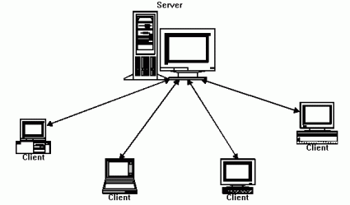
Servers vs. Clients
Web Server → a computer that delivers (serves up) web pages
Client → the computer that is requesting to see/visit the web page.
Many clients will visit one web server, for example 20,000 students might visit Western’s web server to see the page: http://publish.uwo.ca
We will put/post our web pages on the Western web server so clients can see our pages.

Slide 7
Advantages of a Web Server
Connected: Computer is on all the time and connected to the Internet
Always Available: Since it never gets turned off, your website will always be available
Well Maintained: The people running the servers will take care of security and computer maintenance issues

Slide 8
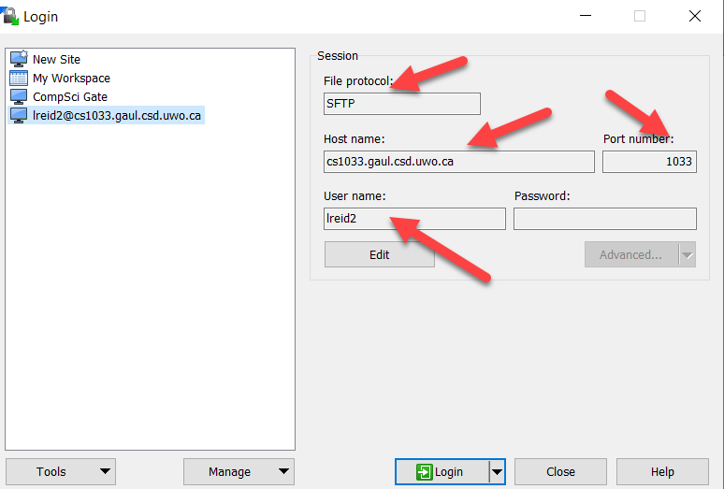
Uploading our Web Pages to a Web Server
Upload by using a File Transfer Protocol program such as:
WinSCP
FileZilla
Cyberduck – THIS IS A GREAT ONE FOR MAC USERS!
WS-FTP
Fugu (for Mac)
Log on to the Web Server by select Secure File Transfer Client, click on the Quick Connect button and entering the following
cs1033.gaul.csd.uwo.ca
Your userid
Your password
Port 1033

Slide 9
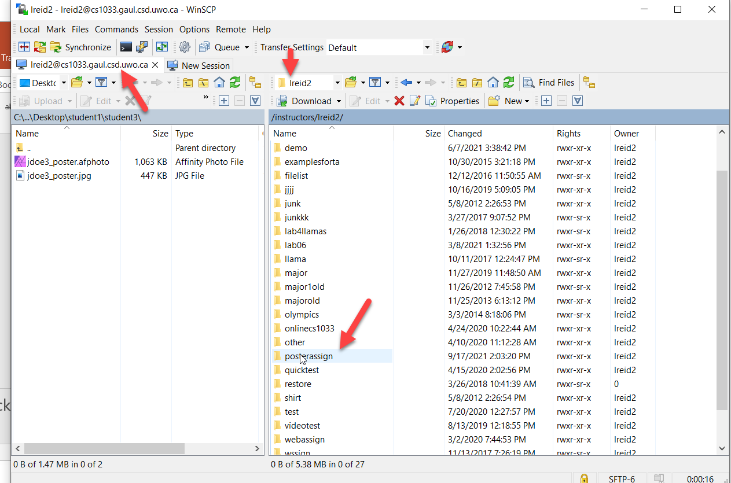
Using WinSCP
Create a folder inside your area called posterassign
Then drag the files from your laptop/lab machine to your posterassign folder to your area on the machine: cs1033.gaul.csd.uwo.ca
Then you might have to set the permissions on your files and folders (although permissions will likely be set already)

Slide 10
Double check that it worked:
Open a browser like Chrome
Type in the web address: http://cs1033.gaul.csd.uwo.ca/~youruserid/foldername
For example:
http://cs1033.gaul.csd.uwo.ca/~lreid2/posterassign
usually when things don’t work it is because your permissions are wrong or you didn’t use all lowercase!

Slide 11
Handing in Poster Assignment
Step 1: Create your assignment in Affinity Photo
Step 2: Save your file as a afphoto and jpg with the correct file name
Step 3: SFTP to cs1033.gaul.csd.uwo.ca
Step 4: create a folder called posterassign
Step 5: move the .afphoto and .jpg files into posterassign folder
Step 6: using IE (Chrome, Safari or Firefox) double check that you can see your jpg

Slide 12
Handing in Poster Assignment
Step 7: Create a file in a simple text editor such as Notepad (.txt)
Step 8: Put the necessary info in the .txt file
Step 9: Log onto kritik.io and go to Poster Assignment
Step 10: (CREATE STAGE) Copy the information in the .txt file into the Assignment Text box in kritik.io for Poster Assignment
Step 11: Press the Submit button
Step 12: (EVALUATION STAGE – 2 to 3 days) Then you will be notified of the 5 other assignments you have to mark via kritik.io
Step 13: (FEEDBACK STAGE – 1 day only!) Once you have marked the 5 students assigned to you, you will need to review the comment each of the students who marked you gave and submit your review.
YOU’RE DONE!

Slide 13
Big Ideas For This Week
Big Idea 1: Size Matters → Squishing is important in computer science!
Big Idea 2: Gif vs Jpg vs Png → Make the right choice!

Slide 14
How Does Compression Work?
Several different ways to do compression depend on the type of image
Are you willing to do a lossy compression and lose some of the original information?
For example: When packing a suitcase, what are you two options for filling the suitcase?
A. Folding carefully and sitting on the case!
B. Leaving some unimportant stuff at home and using a smaller case!
QUESTION: Which is lossy and which is lossless?

Slide 15
Compression for images with large blocks of the same colour
Assume this is an image (boring though it may be!) we want to compress.
Say the image is 100 pixels high and 200 pixels wide, so we would have to store info about 20,000 pixels.
We need to store the color of every pixel
NOTE:
the yellow is: #FFFF00
the green is: #00CC99
100 pixels high
200 pixels wide

Slide 16
Compression Concepts
RAW has no compression –large file
A RAW stores the information about each pixel, one at a time, so the RAW file would look something like this: (Starting at the top, left corner, going left to right, ending at the bottom right)
Each color is 3 byte, so that is 60,000 bytes of information we are storing
100 pixels high
200 pixels wide
#FFFF00 #FFFF00 #FFFF00 #FFFF00 #FFFF00 … #FFFF00 #00CC99 #00CC99 … #FFFF00
YellowWithGreen.raw

Slide 17
Compression Concepts
Can anyone think of a way to store the data about the color of each pixel, without losing any information (lossless compression) and do it in less than 60,000 bytes
(0,100)
(200,100)
100 pixels high
← HINT
200 pixels wide
(0,0)
(200,0)

Slide 18
Compression Concepts
Record (store) this info: startx,starty,endx,endy,color
0,50,200,100, #FFFF00
0,0,80,50, #FFFF00
80,0,130,20, #FFFF00
130,0,200,50, #FFFF00
80,20,130,50, #00CC99
(200,100)
(80,50)
(130,50)
(200,50)
(80,20)
(130,20)
Store:
startx= 1 byte
starty = 1 byte
endx = 1 byte
endy = 1 byte
color = 3 bytes
Each shape: record 7 bytes
Multiply by 5 shapes = 35 bytes!
(0,0)
(200,0)
(80,0)
(130,0)

Slide 19
AMAZING:
35 bytes vs 60,000 bytes!
NOTE:
This idea works great with rectangular shapes but gets a lot more complicated when curves are involved!
GIF compressions are, in reality, a bit, a lot more complicated
Thus compression aids with making smaller file size…downloads faster images

Slide 20
Other Compression Ideas
Looks for patterns, for example: 143451434514345
If “1” represents pattern 14345, compresses it to “111”
Build a decoding hash table
0 13245
1 14345
2 23423
3 11223
Pattern:
1324523423143451122323423
Based on table will map to
02132

Slide 21
Compression Tricks – Compressing Words (for example text in a dictionary)
ASCII Code – each letter is represented by 8 bits (1 byte)
Question: Which letter is the most common in the English language?
Huffman Coding - rather than ASCII (each letter is 8bits or 1 byte) use the least number of bits for common letters and more bits for less common letters → Sample Huffman code
QUESTIONS
How many bytes will the word “see” be in ASCII? in Huffman?
How many bytes will the word “zoo” be in ASCII, in Huffman?

Slide 22
ASCII code
Huffman code
see
zoo
s=8 bits
e=8 bits
e=8 bits
----------
see = 24 bits (in ASCII code)
s=4 bits
e=3 bits
e=3 bits
-----------
see = 10 bits (in Huffman coding)
z=8 bits
o=8 bits
o=8 bits
----------
zoo= 24 bits (in ASCII code)
z=11 bits
o=4 bits
o=4 bits
-----------
zoo = 19 bits (in Huffman coding)

Slide 23
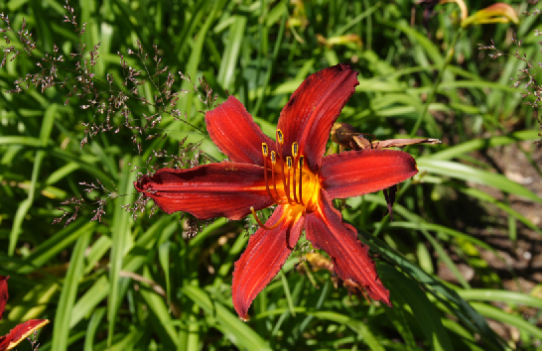
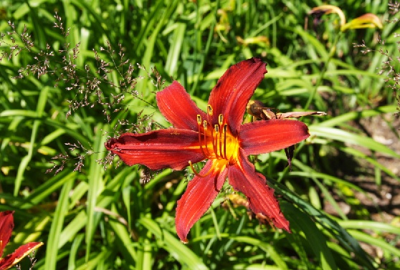
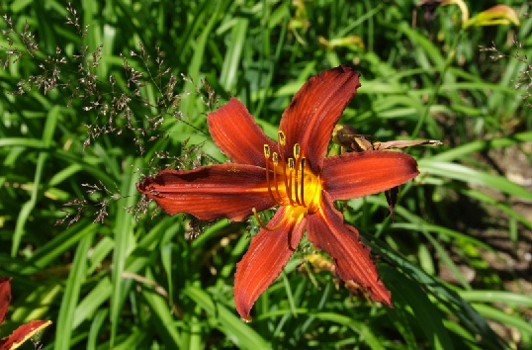
Other Compression Ideas
How do our eyes see images?
QUESTION: which one looks more different from the original image?
Original Image
A. Brightness Adjusted Slightly
B. Colour Adjusted Slightly

Slide 24
Brightness vs. Colour
The designers of the JPEG compression algorithm realized that the human eye is more sensitive to brightness details than to fine color details. (This is an example of how Biology and Computer Science and Physics overlap ☺ !)
If it finds two adjacent pixels with very similar colors, it will store both those pixels with the same color and discard the other color.
https://www.youtube.com/watch?v=Jcgg7jq1W3o&list=PLQMVnqe4XbictUtFZK1-gBYvyUzTWJnOk

Slide 25
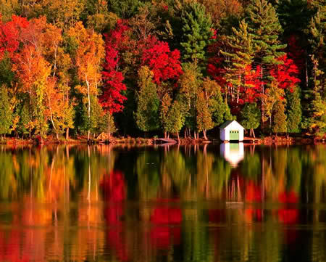
How do we pick the most appropriate file format?
Depends on what type of image we are representing
QUESTIONS:
How many colours are needed for the first image?
How many for the second image?

Slide 26
Depends on type of image!
The type of image we are trying to compress will determine the best file format to choose!
3 file formats we will look at:
GIF
JPG
PNG

Slide 27
GIF (Graphic Interchange Format)
Widely used on the World Wide Web
Cross Platform (works on Macs, Windows)
ONLY supports 8 bit colour!
QUESTION: How many colours can you have in a GIF file if it allows for 8 bit colour?
Not great for photographs but good for clipart, logos, animation
Looks for large blocks of area that all have the same colour
Saving an image with 24 bit colour as a gif will lower the quality the first time you convert it to a gif

Slide 28
GIF
Produces smaller file sizes than jpgs
Does a lossless compression:
Assume we have an image that is
200 by 200 pixels
If the original image had 256 colours or less
With no compression the file size would be: 200*200*3/1024 = 117 KB
Same image, save as a gif:
With 256 Colours → 8.4 KB
With 16 Colours → 5 KB
NOTICE: NO CHANGE IN QUALITY, LOSSLESS COMPRESSION!

Slide 29
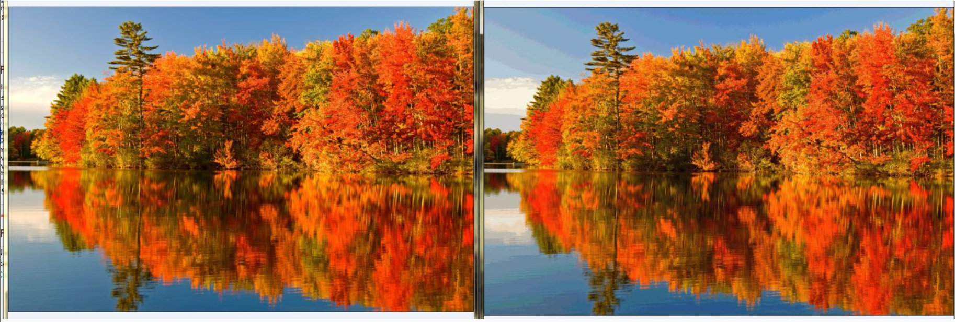
GIF
Not great for photography because can only store 256 colours.
QUESTION: Can you tell which image has fewer colours?

Slide 30
GIF → Transparency
One Colour Transparency
Allows for transparency of ONE colour
Background will show through:
Question: Can you see the problem with this type of transparency?

Slide 31
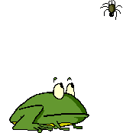
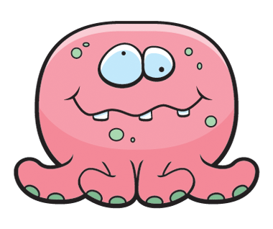
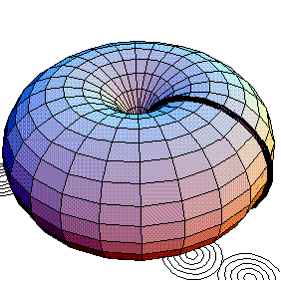
GIF → Animation
Allows for animation
Don’t need a plug in for gif animation!
Works in all browsers, universal format!

Slide 32
GIF → Dithering
Allows for dithering:
Question: What do you think a program, that converts images into gifs does, if the image has more than 256 colors?
Solution 1: Substitute one of the colors you have for one of the colors you are missing
Solution 2: Any guesses?
HINT: What did you do when you were a kid and your parent gave you red and blue and yellow and black play-doh?
you didn’t realize it but you were using a 2-bit color depth play-doh palette = 2² = 4 colors

Slide 33
GIF → Dithering
Juxtaposing (place side by side) pixels of two colors to create the illusion that a third color is present (grainy look)
Example:
Assume our image uses 257 colours
The 257th colour that is not in our palette is:
Assume we do have these 2 colours: and
Thus dithering will change this →
To this →

Slide 34
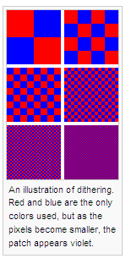
Another Example of Dithering

Slide 35
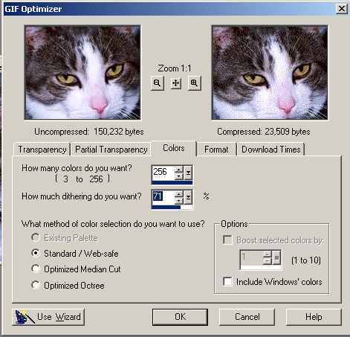
GIF → Dithering
You can reduce the number of colors in a GIF and choose options to control the way colors dither in the application or in a browser.
Different ways to dither produce different results

Slide 36
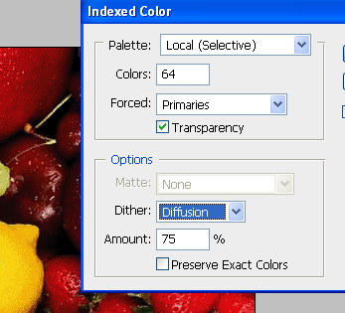
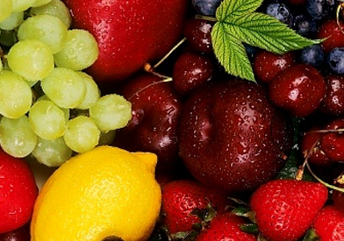
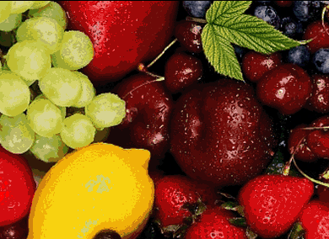
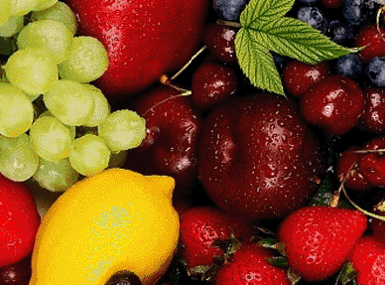
GIF → Dithering
← Original Image
Dithering, used 64 colours to make the differences show up more to the naked eye!
Saved as 6 bit gif with no dithering
Saved as 6 bit gif with dithering
Notes:
Saved with 64 colours to show differences better

Slide 37
GIF → Interlacing
How images are downloaded to your screen
Interlacing lets you have a feel for the whole picture, you don’t have to wait around to see it download (good for dial up connections)
a process by which the image is drawn in a series of passes rather than all at the same time (file size bigger)

Slide 38
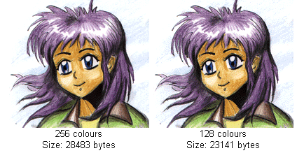
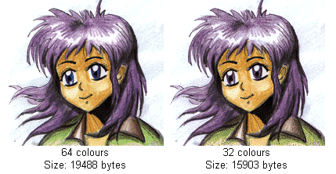
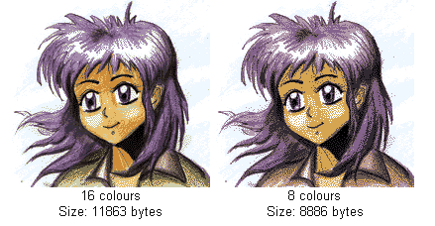
GIF → Compression
Can compress more by reducing the number of colours in the image:
Colour Resolution | Size (KB) | % Decreased
256 | 28,483
128 | 23,141 | 19
64 | 19,488 | 32
32 | 15,903 | 44
16 | 11,863 | 58
8 | 8,886 | 69

Slide 39
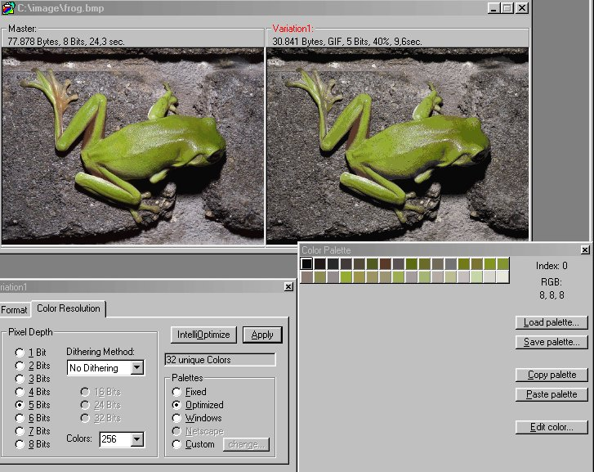
GIF

Slide 40
JPG (JPEG) – Joint Photographic Experts Group
Widely used on the World Wide Web
Cross Platform (works on Macs, Windows)
Supports 24 bit colour
Question: How many colours can you have in a JPG file if it allows for 24 bit colour?
Great for photographs
Larger file sizes than GIFs BUT allows for a full colour scheme!

Slide 41
JPG
Good for photographs, computer games, screenshots, stills from a movie, etc
Best for blends of color, softer shadow effects, subtle changes in color
Not good for well-defined lines or sharp contrasts between colours
Question: Guess which one is the GIF and which one is the JPG:

Slide 42
JPG
Notice what happened to Homer when his original GIF was resaved as a JPG:

Slide 43
JPG
JPG does a lossy compression
Discards more data about colours than about brightness
Not all of the information in the original image is preserved – not the same as the original
Degrades the image quality
Compression is achieved by ‘forgetting’ certain details about the image, which the JPG will then try to fill in later when it is being displayed
Degree of amount of information LOST (lossyness) can be varied by adjusting compression parameters. (controlled by you)
Because image data is lost with each compression, work with the image in native format, and when ready with final product, save it as a .jpg file

Slide 44
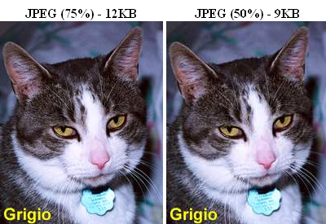
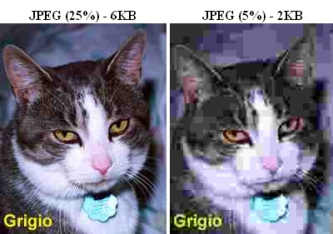
JPG
Original → 0% Compression = 100% Quality
Quality of image is inversely proportional to amount of compression
A higher image quality setting (has a lower compression value) results in less data being discarded.

Slide 45
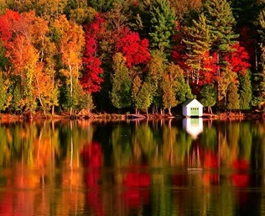
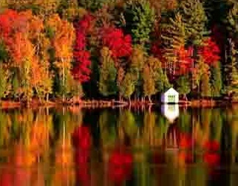
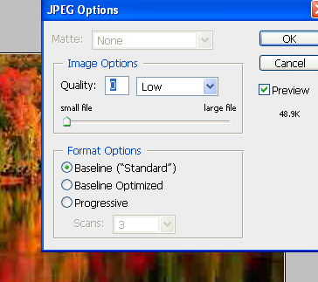
JPG
Can you tell which image was saved with low quality, high compression in Photoshop?

Slide 46
JPG
No Transparency
No Animation
No Interlacing
No dithering (Question: why no dithering?)

Slide 47
PNG
Pronounced PING
Created specifically because of licensing issues with GIFs in the 90s
Does LOSSLESS compression
Three versions of PNG
PNG-8
PNG-24
PNG-32

Slide 48
PNG-8
Similar to GIF
Only allows for 256 colours
Allows for 1 transparent colour
Storing of colours is more efficient in PNG files than GIFS thus PNG-8 files might be SMALLER than their GIF counterparts (this is software dependent)

Slide 49
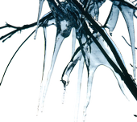
PNG-24 (and PNG 32)
Allows for 24 bit colour
It is LOSSLESS
QUESTION: If I take the same image and save it (same quality level) as JPG file, then as a PNG-24 file, which file size will be smaller? (keep in mind that jpgs are lossy and pngs are lossless).
Allows for transparency on each pixel, with different levels of opacity:
PNG 32 allows for a full palette with full transparency but with PNG 24 if you want varying levels transparency, you will lose some colours

Slide 50
Comparison of GIF, JPG, PNG
 | GIF | JPG | PNG-8 | PNG-24/PNG-32
Best For | Logos, Cartoons, Drawings | Photographs | Logos, Cartoons, Drawings | Photograph Images with a need for transparency
Type of Compression | Lossless | Lossy | Lossless | Lossless
Well Supported in Browsers | All | All | All | Not on IE6
Transparency | One COLOUR only | NO | One COLOUR only | Varying levels of opacity and transparency
Animation | Yes | No | No | No
Dithering | Yes | No | Yes | No
Interlacing | Yes | No | Yes | Yes
Shape of image |  | Must be rectangular

Slide 51
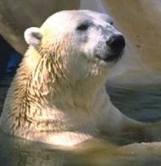
File Size Comparison

Slide 52
Things to think about when working with images:
How big do I need it to be within my page (determines the Width Pixels by Height Pixels)
Will I ever need to print the image (determines the DPI)
What type of picture is it: cartoony or photograph , how many colours (determines GIF vs. JPG)
Will I need 1 colour to be transparent (determines GIF/PNG vs JPG)
Will I need varying levels of transparency in my photograph (JPG vs PNG24)

Slide 53
Nice Review
https://www.youtube.com/watch?v=15aqFQQVBWU

